Slide 1

@NCEPOD
#sepsis

Slide 2

Method
Hannah Shotton

Slide 3
Study Advisory Group
Study proposal
Study Advisory Group
Study design: key themes, method, questionnaire
Acute medicine
Emergency medicine
General practice
Surgery
Intensive care medicine
Microbiology
Pathology
Nursing, critical care outreach
Patient representative

Slide 4
Study aim
To identify and explore avoidable and remediable factors in the process of care for patients with sepsis.

Slide 5
Study objectives
To examine organisational structures, processes, protocols and care pathways for sepsis recognition and management
To identify remediable factors in the management of the care of adult patients with sepsis

Slide 6
Study objectives
Timely identification, escalation and treatment of sepsis: use of systems, EWS, care bundles
Multidisciplinary team approach
Communication:
Primary/secondary care
Healthcare professionals; documentation of sepsis
Patients, families and carers
End of life care

Slide 7
Study population
Adult patients diagnosed with sepsis and admitted to critical care (HDU/ICU) or reviewed by CCOT or equivalent during the study period: 6th-20th May 2014

Slide 8
Exclusions
Pregnant women up to 6 weeks post partum
Patients undergoing chemotherapy, organ transplant
Patients already on end of life care pathway when sepsis diagnosed
Patients who developed sepsis after 48 hours on ICU

Slide 9
Method
Case ascertainment
Prospective case identification
Study contact
Identify cases
Spreadsheet
Clinician details
Case selection
5 randomly selected at each hospital
Questionnaire/ case note request sent to each named clinician

Slide 10
Method
Data collection
Cases reviewed by panel of Reviewers
Assessment form
Identified cases where patient attended the GP
Sent request for GP notes
GP Reviewers
Organisational questionnaire
Acute / non-acute hospitals

Slide 11
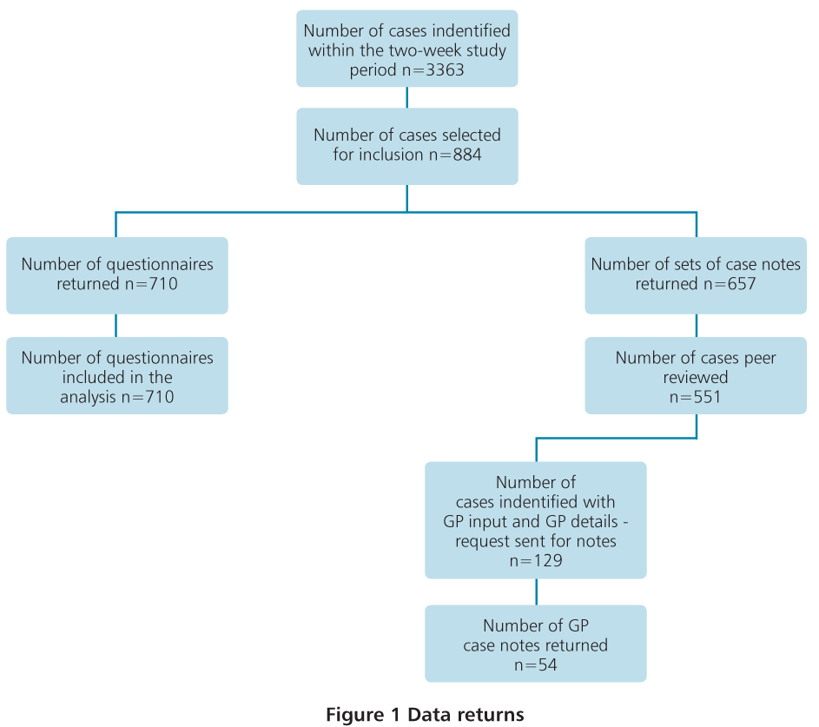
Returns
Returns

Slide 12
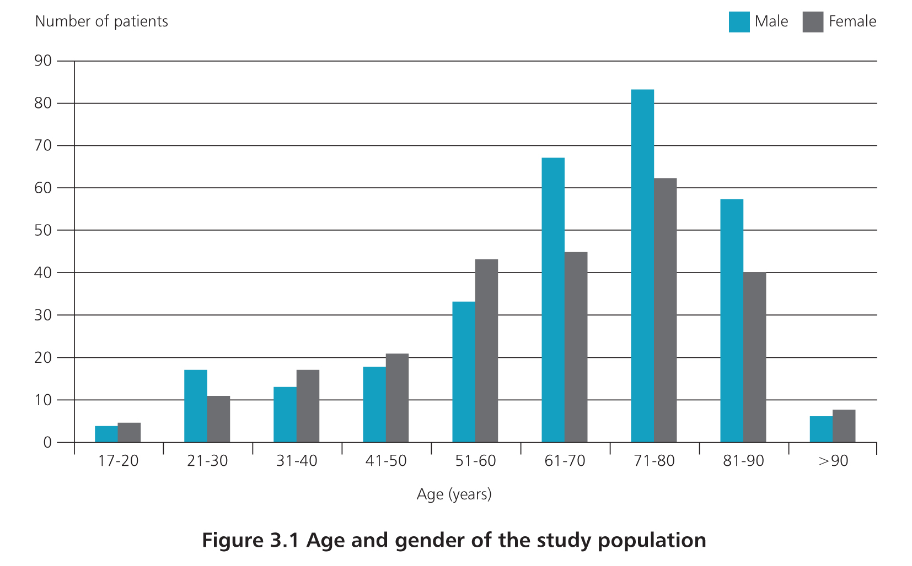
Demographics
Demographics

Slide 13
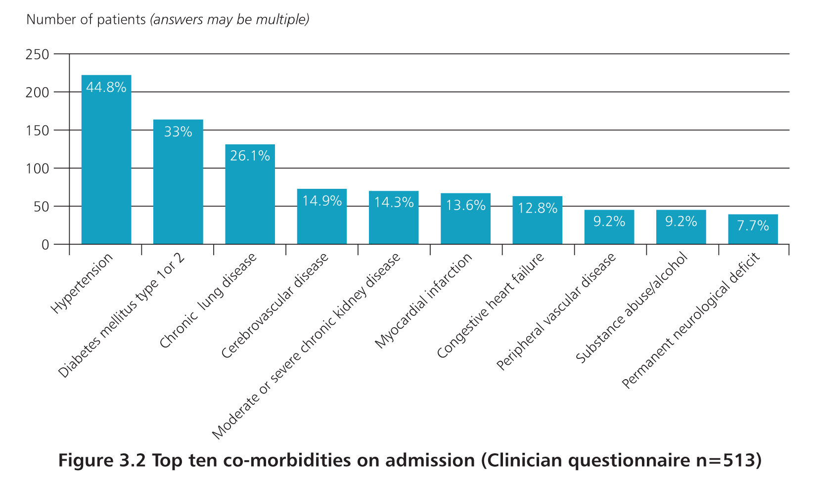
Demographics
Co-morbidities

Slide 14
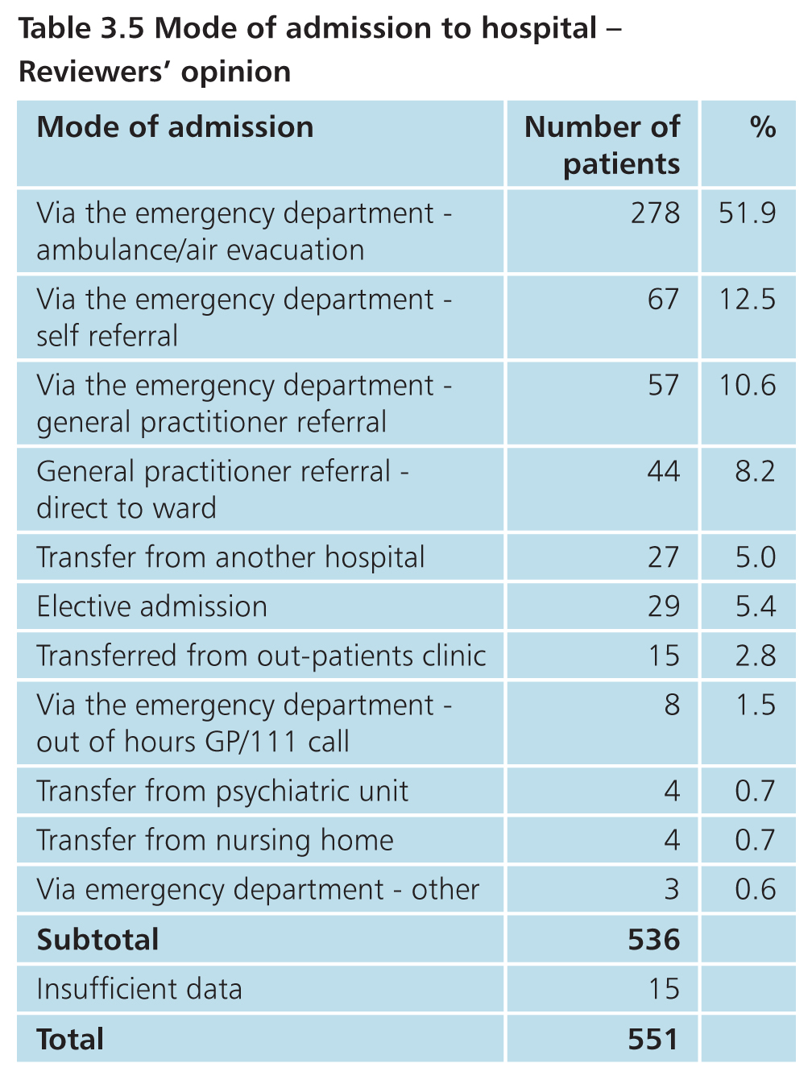
Demographics
Mode of admission

Slide 15
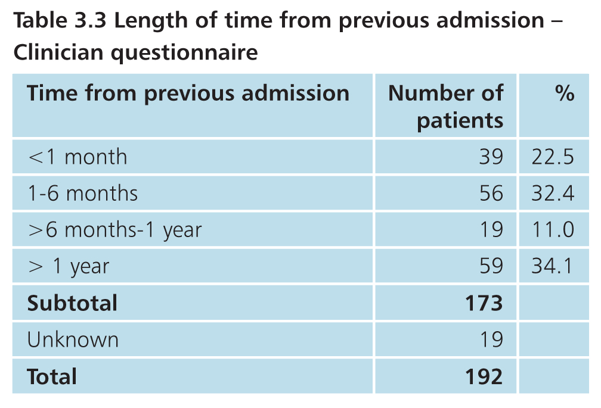
Demographics
Previous admission to hospital
192/702 (27.4%) previous admission for sepsis

Slide 16
Organisational data
Vivek Srivastava

Slide 17
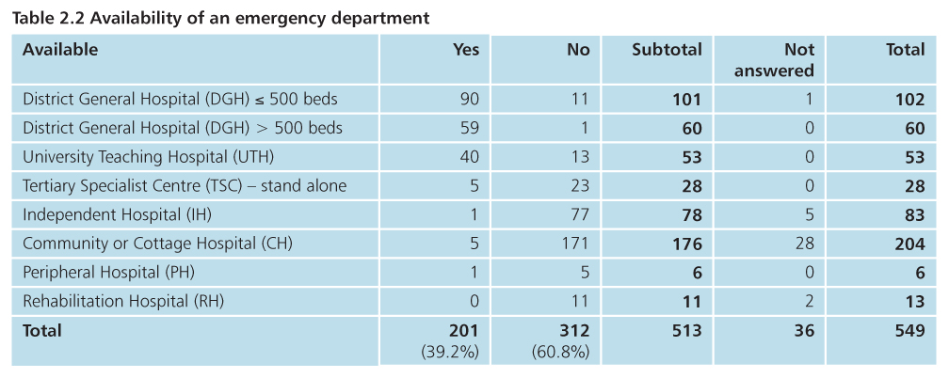
Organisational data
Organisational data

Slide 18
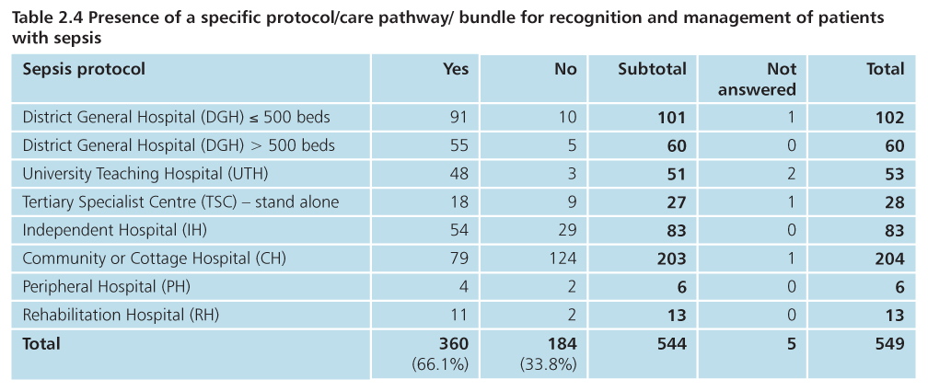
Organisational data
Organisational data
81% protocols are based on national/ international guidance
93% hospitals without a sepsis protocol had a protocol for deteriorating patients

Slide 19
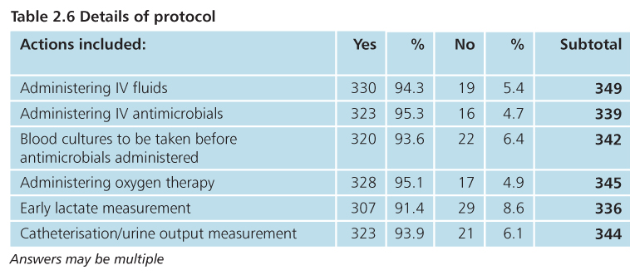
Organisational data
95% protocols – timeframe for actions within 1 hour of diagnosis

Slide 20
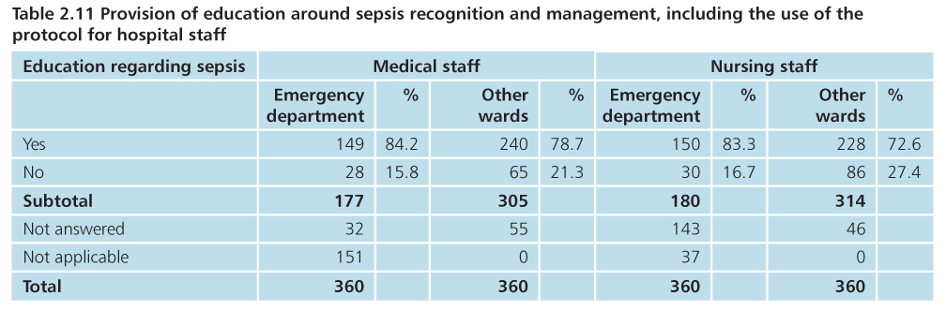
Organisational data
Protocol available on hospital intranet in 97.4% hospitals

Slide 21
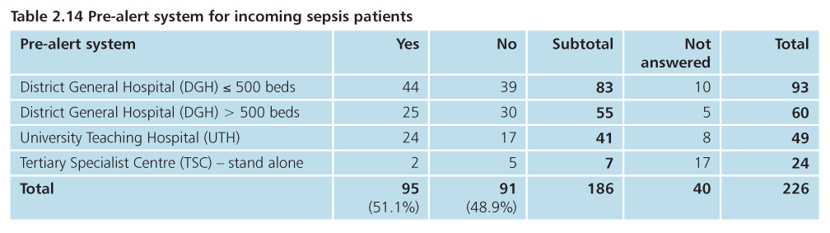
Organisational data
Table 3.21 - Pre-alert sent for 8/133 patients attending the ED

Slide 22
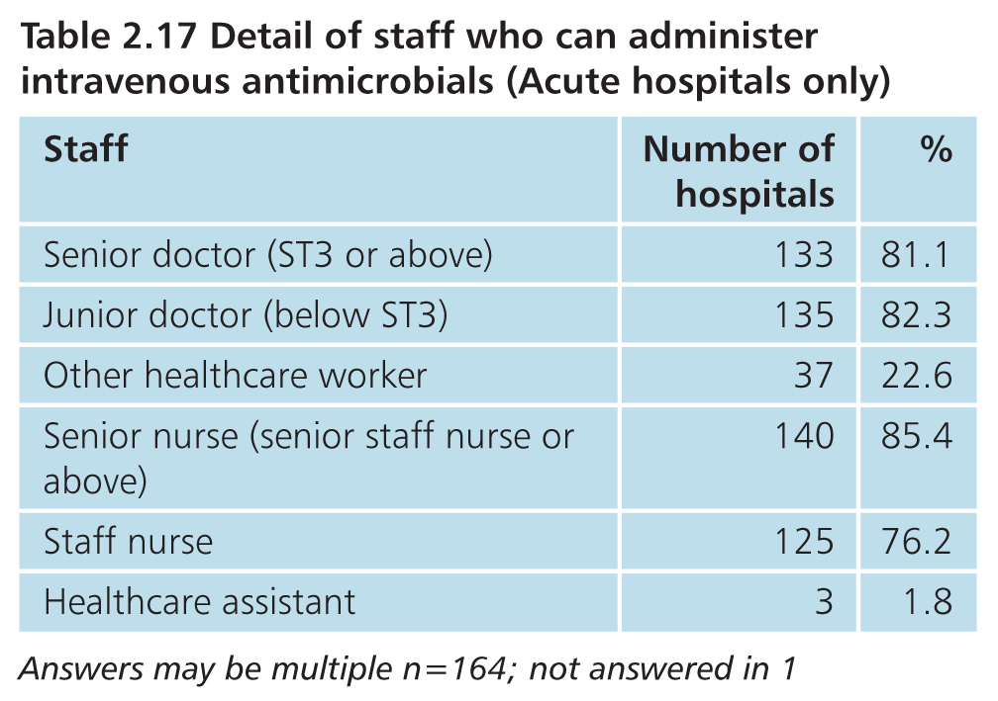
Organisational data
165/216 acute hospitals had a policy for who can administer antimicrobials

Slide 23
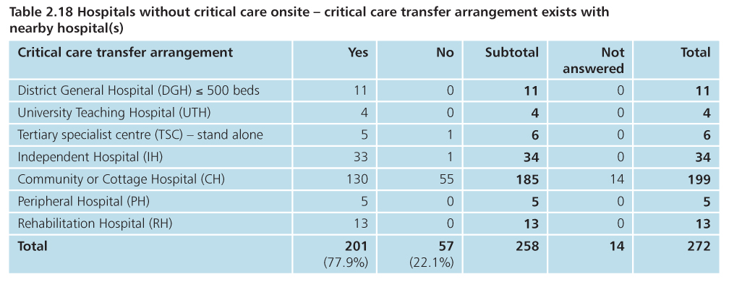
Organisational data

Slide 24
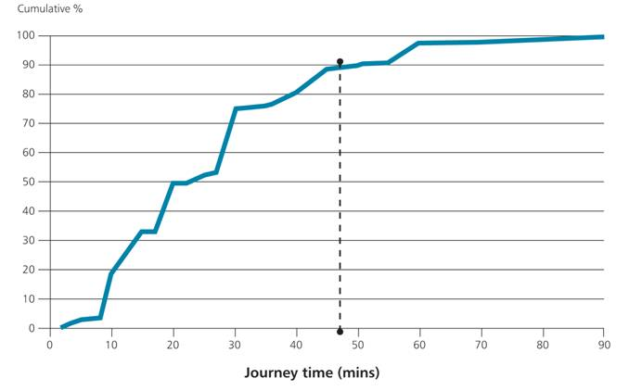
Time to transfer to critical care if not on-site
Organisational data

Slide 25
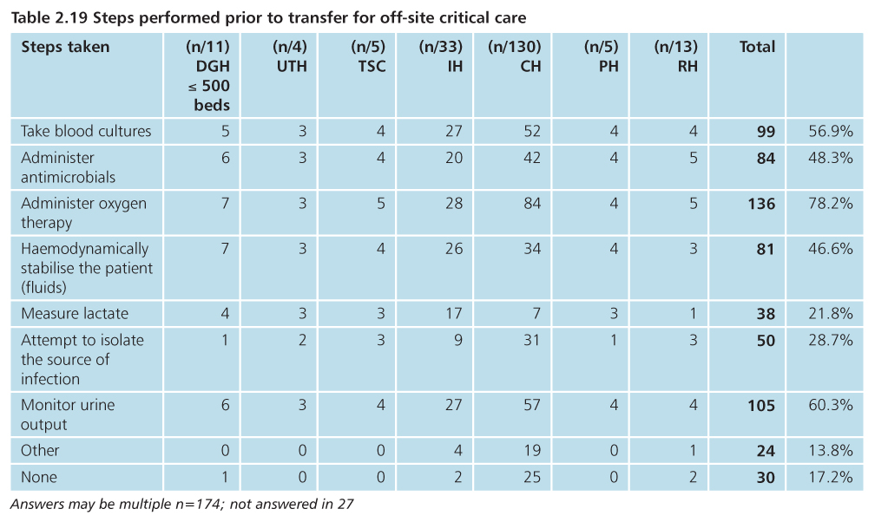
Organisational data

Slide 26
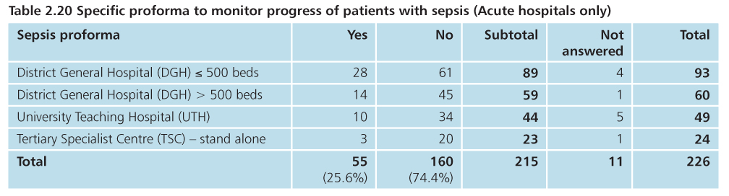
Organisational data

Slide 27
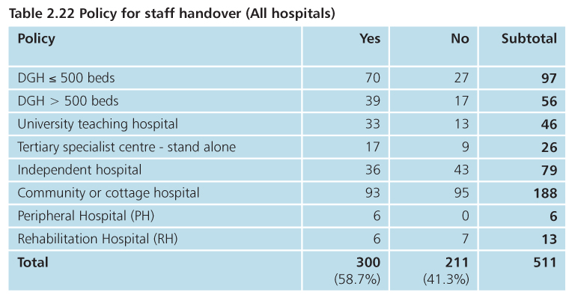
Organisational data
Hospitals with policy - 94% had time set aside for face-to-face handover

Slide 28
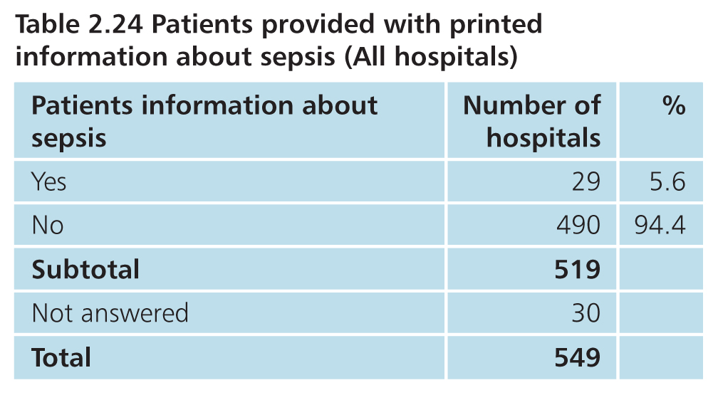
Organisational data

Slide 29
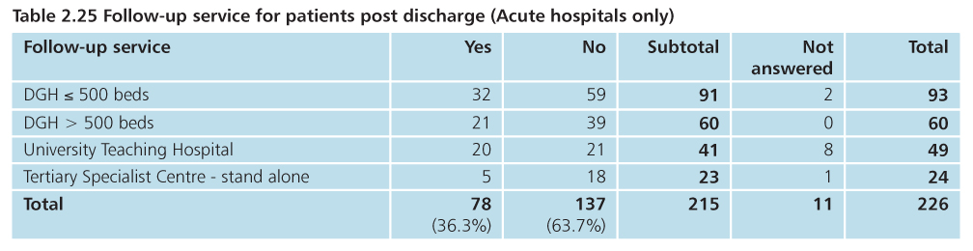
Organisational data

Slide 30
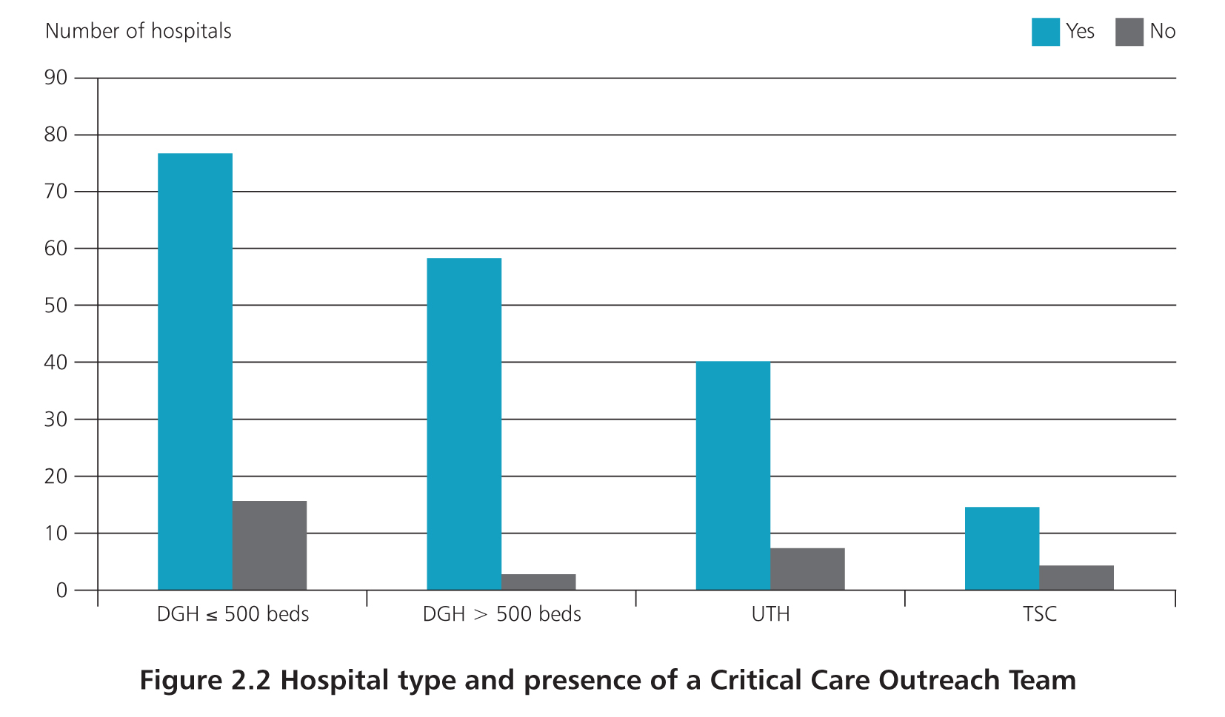
Organisational data
199/223 (89%) hospitals with critical care have a CCOT

Slide 31
44.2% of hospitals had CCOT

Slide 32
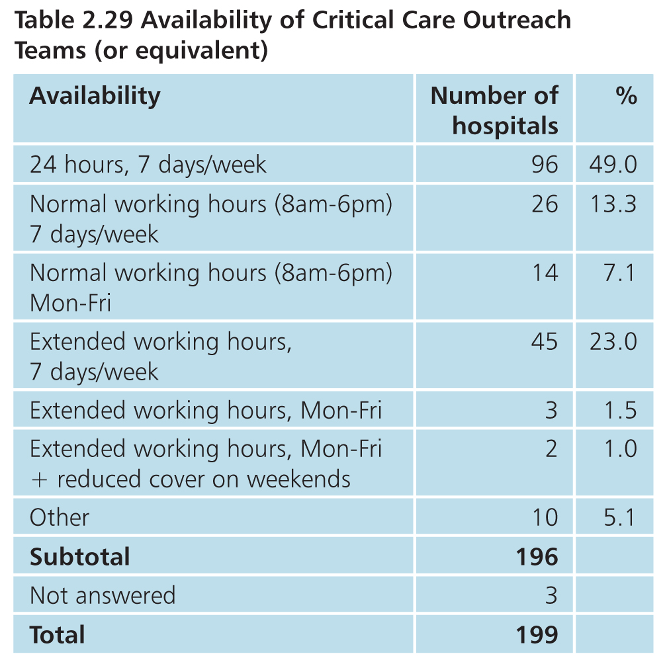
Organisational data

Slide 33
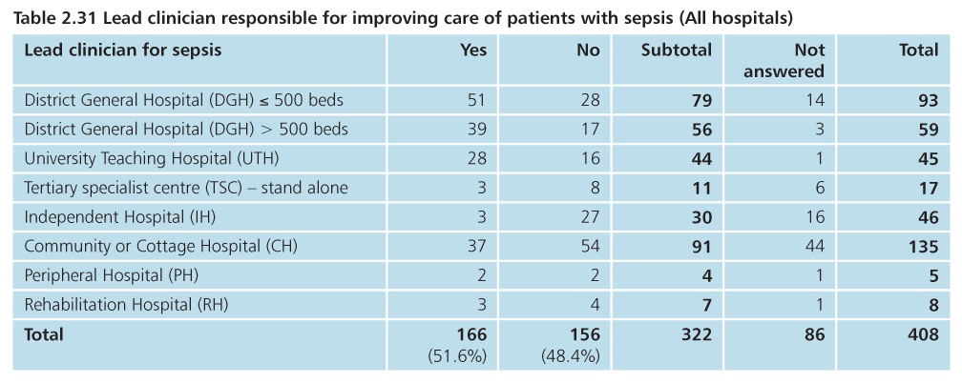
Organisational data
Sepsis nurse in 11%

Slide 34
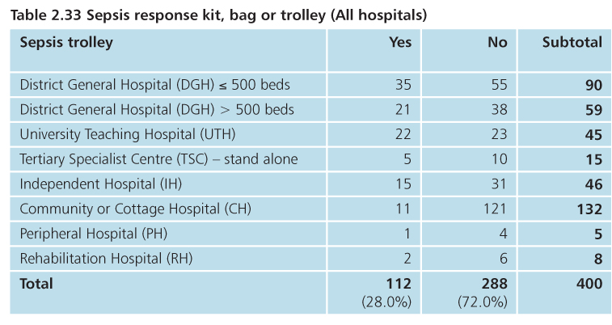
Organisational data

Slide 35
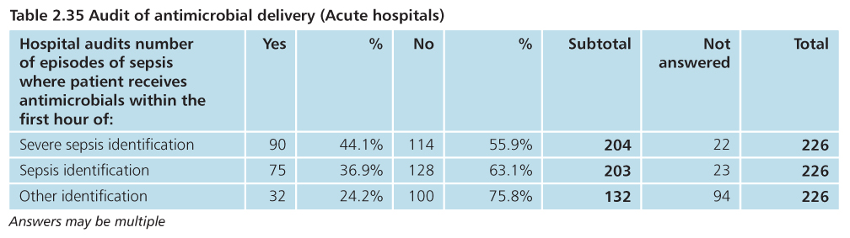
Organisational data

Slide 36
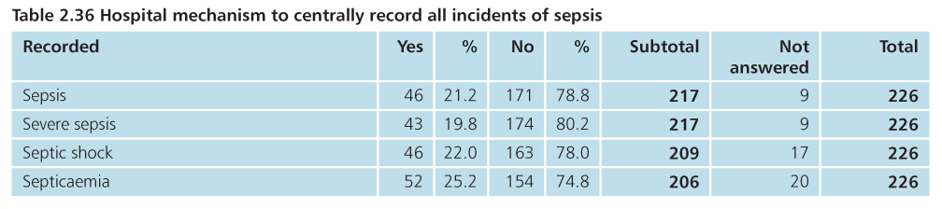
Organisational data

Slide 37
Pre hospital care
Vivek Srivastava

Slide 38
Pre hospital care

Slide 39
Pre hospital care
129 hospital notes had details of GP consultation
Named GP contacted requesting their notes from the last 3 contacts before admission
60 sets of notes returned
54 suitable for review
3 GP case note reviewers recruited and trained

Slide 40
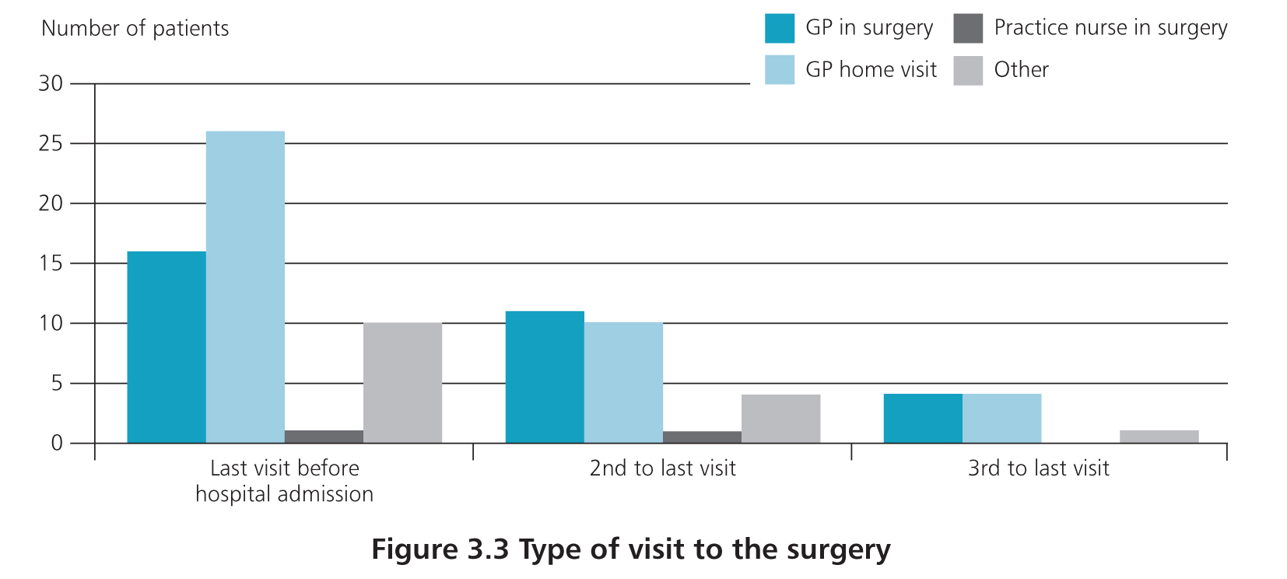
Pre hospital care
Last visit before hospitalisation:
16/54 in surgery
27/54 home visit
10/54 other: telephone/nursing home

Slide 41
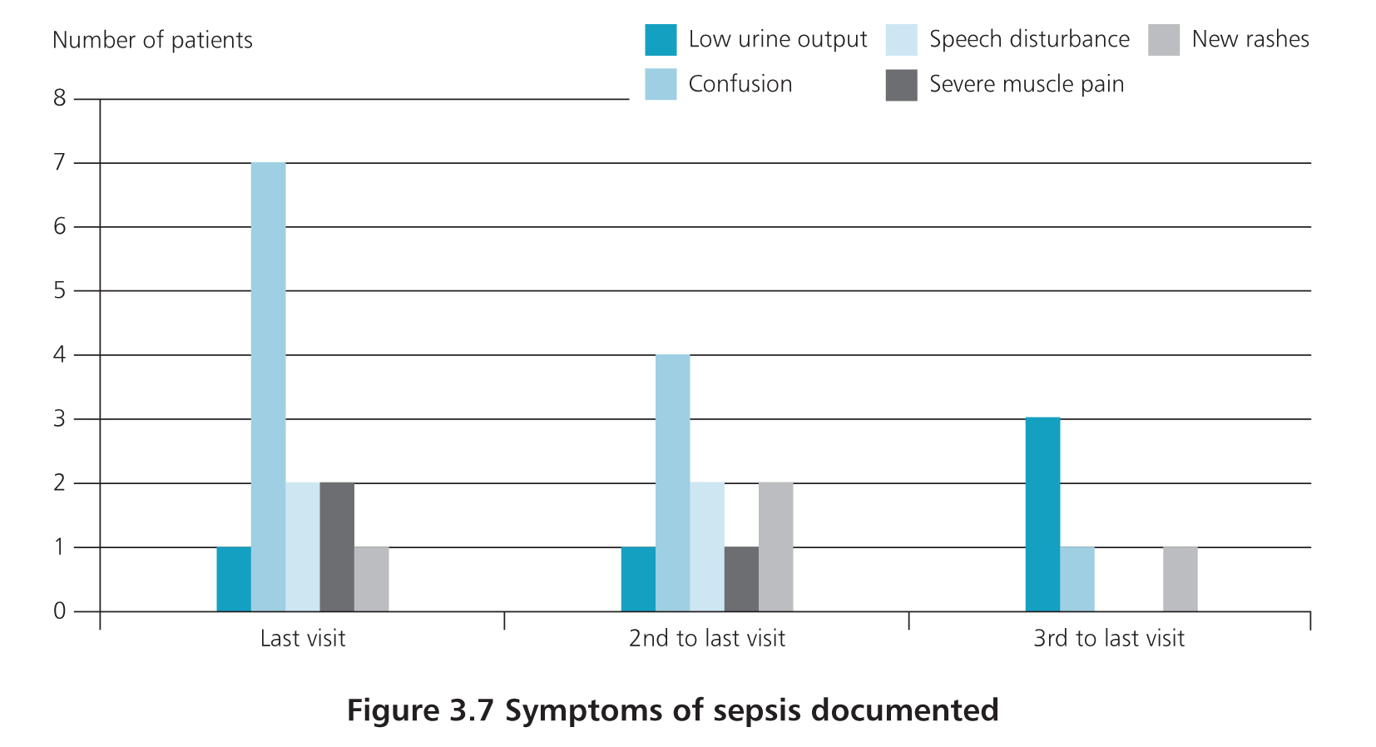
Pre hospital care

Slide 42
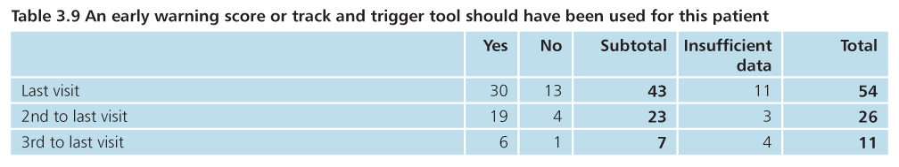
Pre hospital care
EWS was not used in any of the cases reviewed

Slide 43
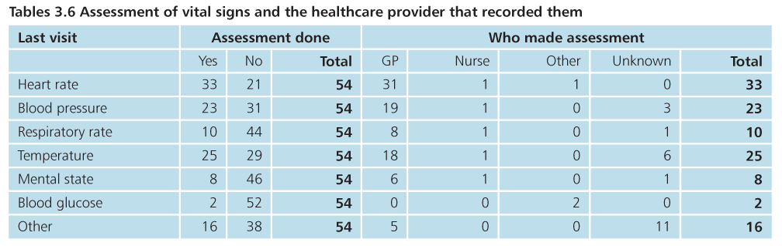
Pre hospital care
GP case note review

Slide 44
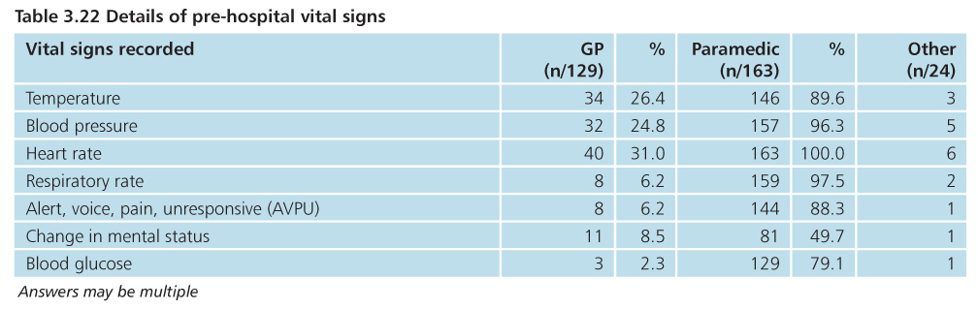
Pre hospital care
Hospital case note review

Slide 45
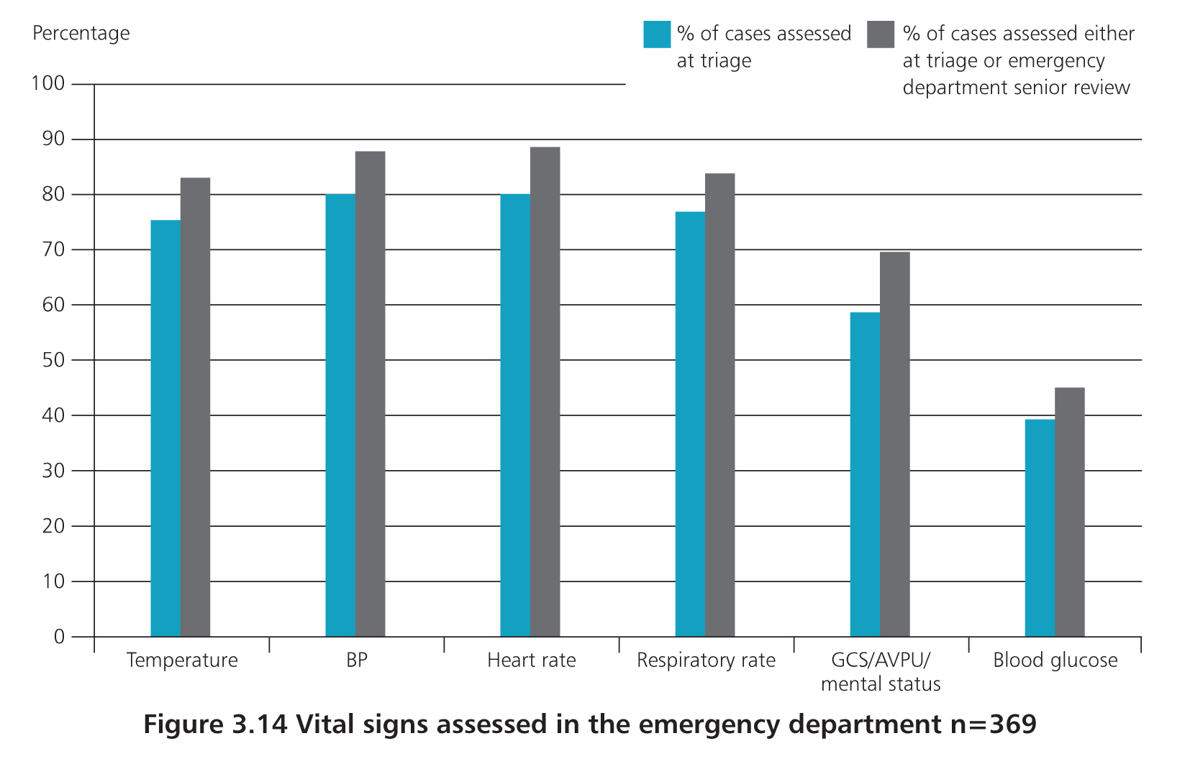
37 patients had no vital signs recorded at triage or senior review 152 patients complete set between 2 assessments
Emergency care

Slide 46
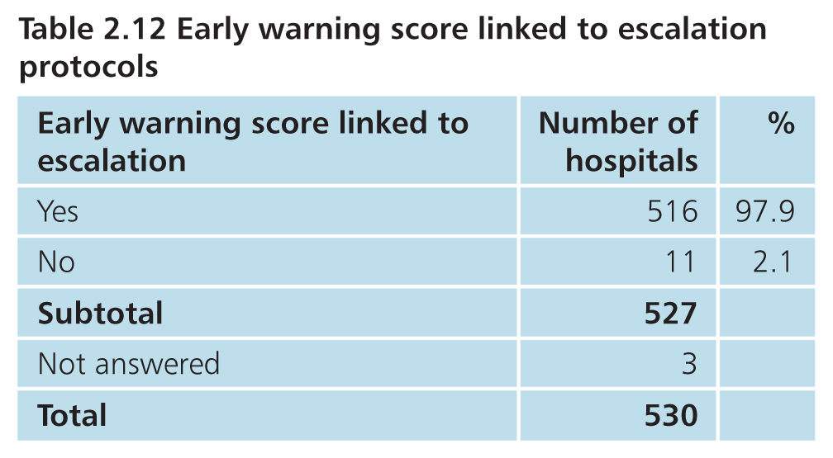
Organisational data

Slide 47
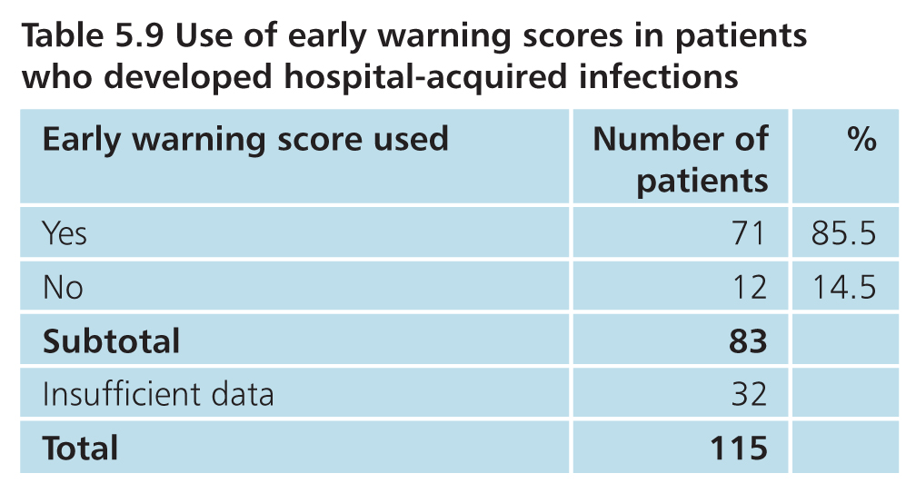
Inpatient care

Slide 48
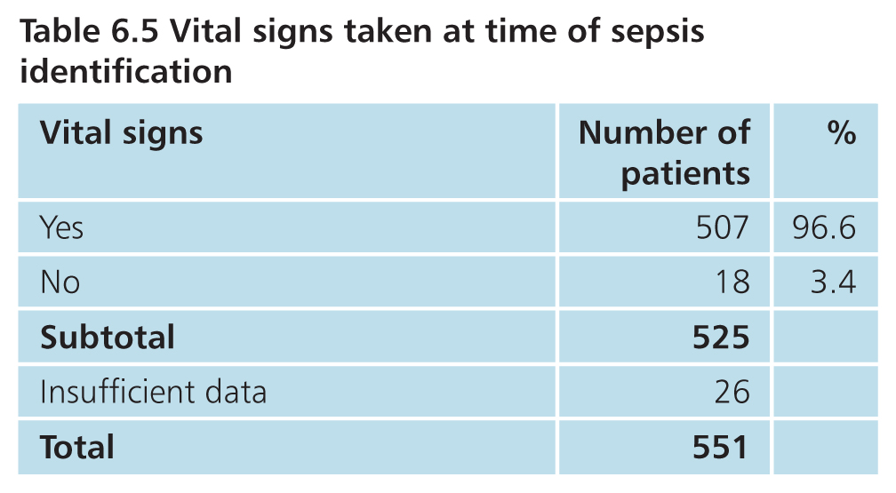
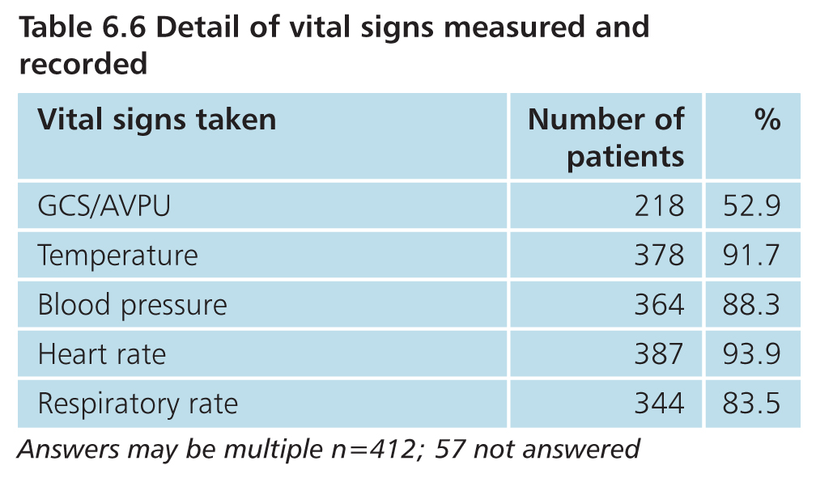
Inpatient care

Slide 49
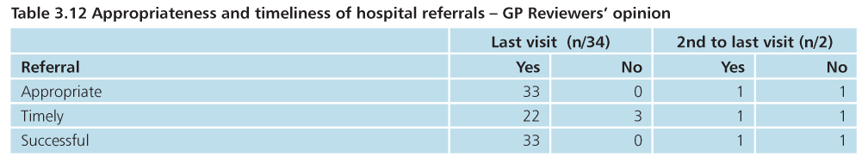
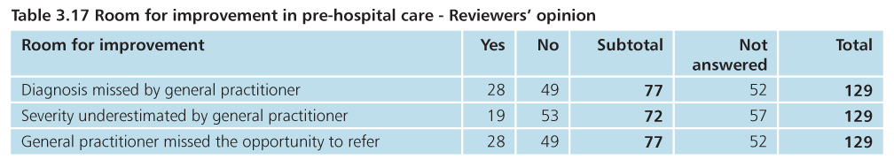
Pre hospital care

Slide 50
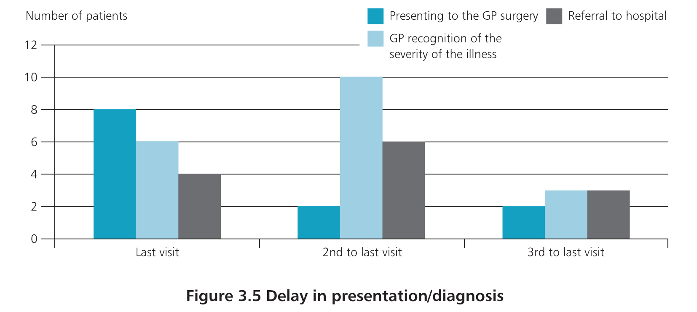
Pre hospital care

Slide 51
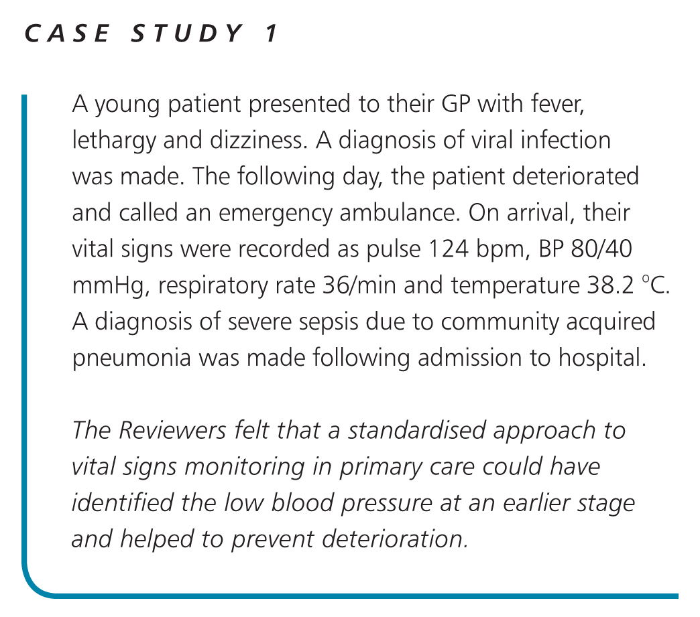

Slide 52
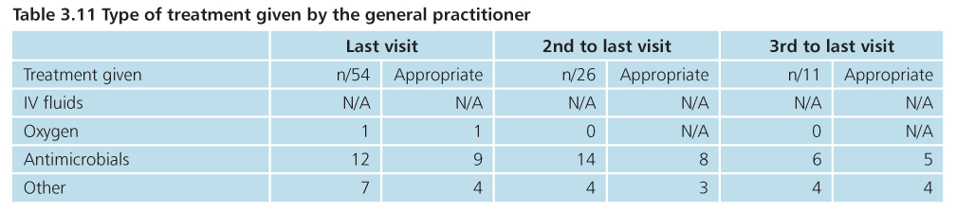
Pre hospital care
GP case note review

Slide 53
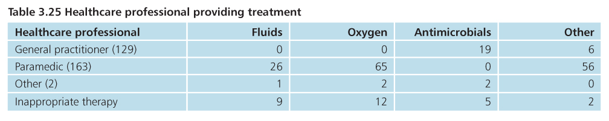
Pre hospital care
Hospital case note review

Slide 54
Emergency care
Vivek Srivastava

Slide 55
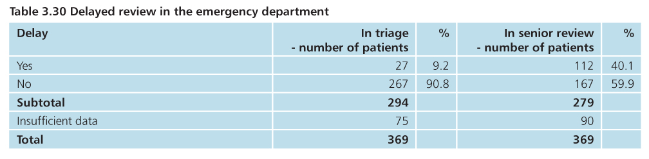
Emergency care

Slide 56
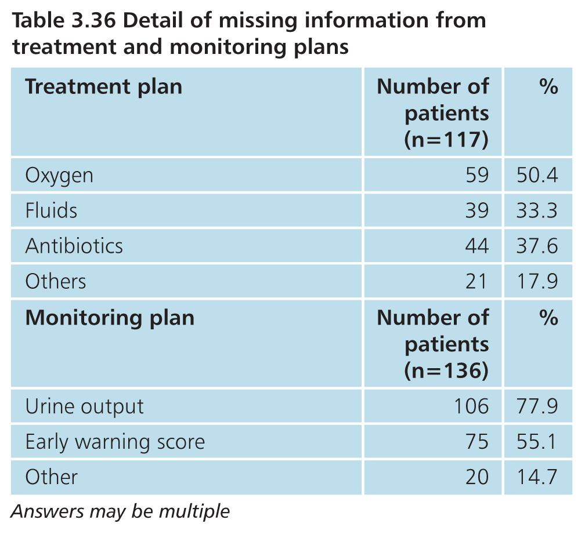
Emergency care

Slide 57
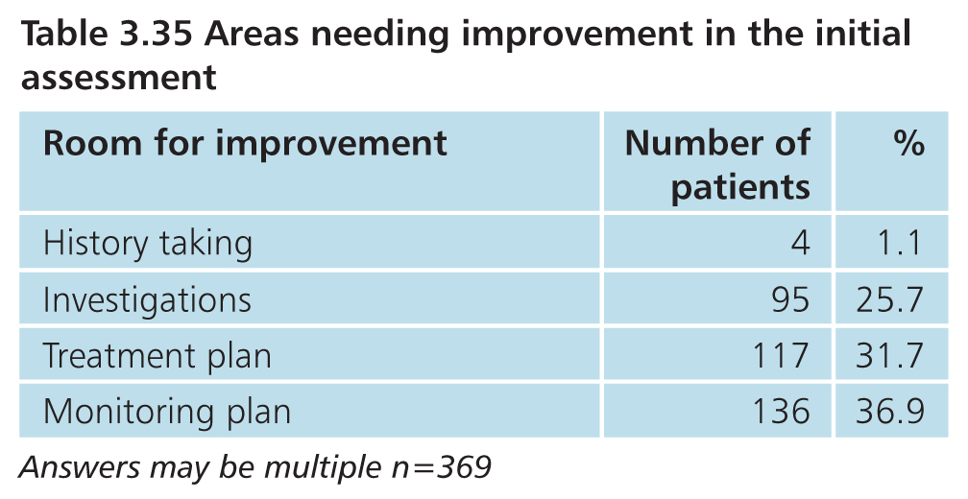
Emergency care

Slide 58
Inpatient care
Alex Goodwin

Slide 59
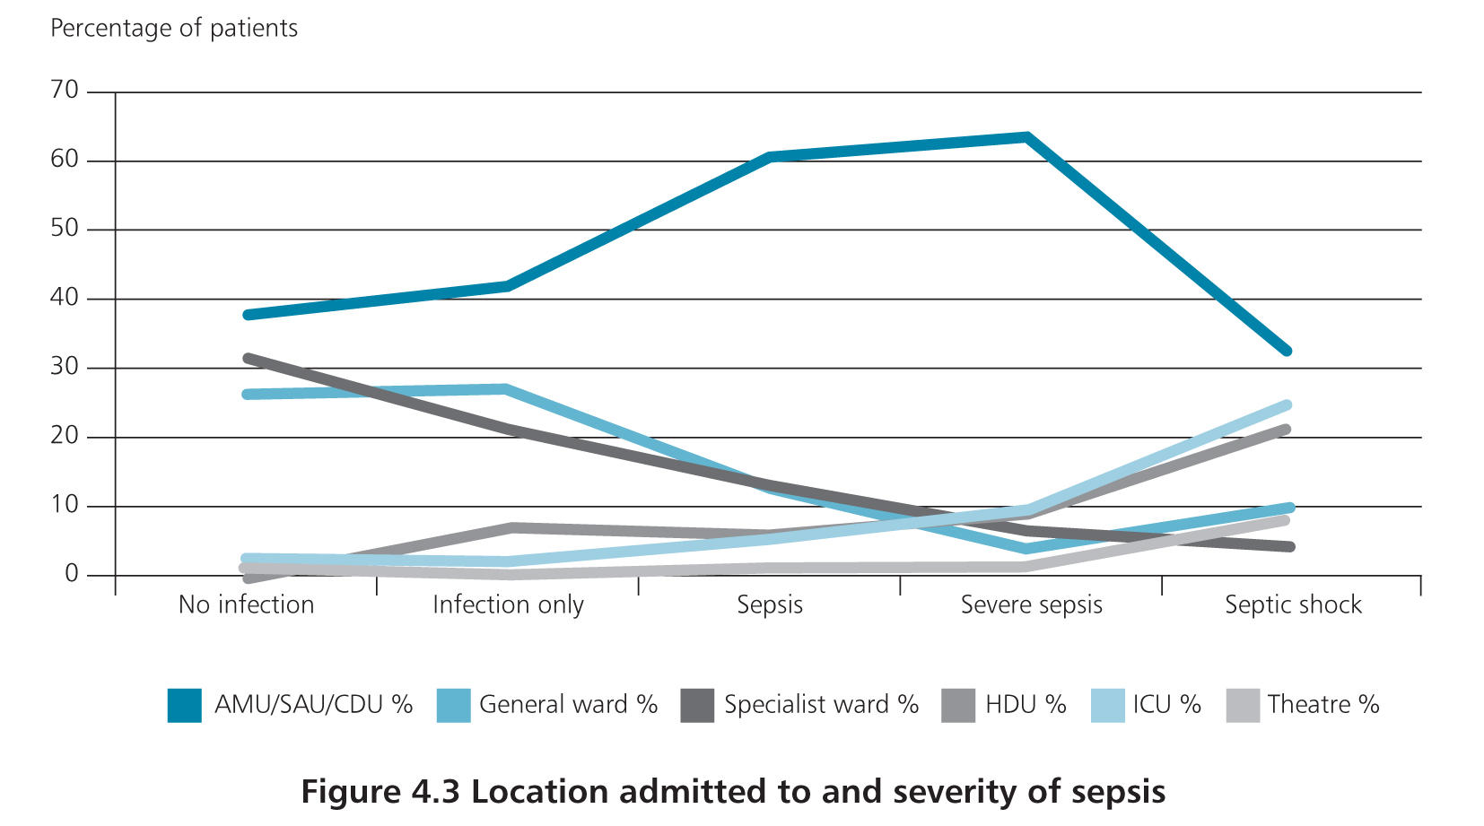
Inpatient care
Correct location according to Reviewers in 93%

Slide 60
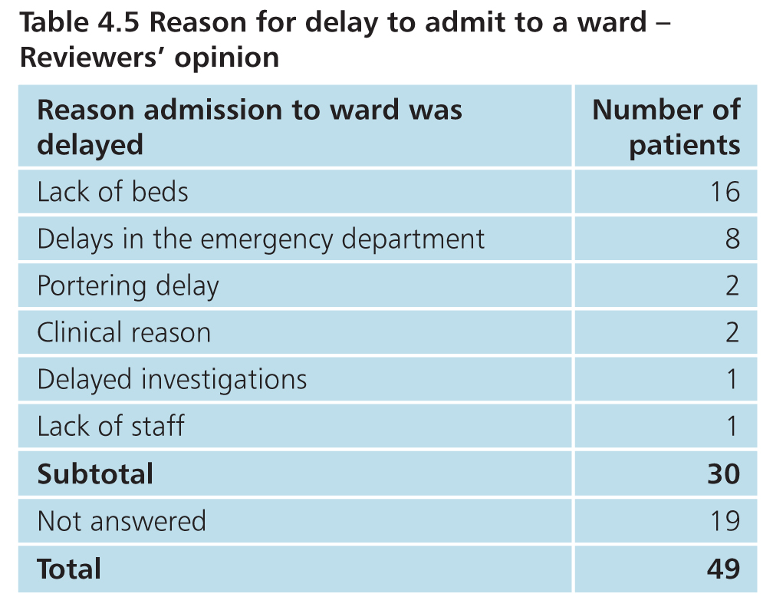
Inpatient care
Admission to ward delayed in 49/361 (13.9%)

Slide 61
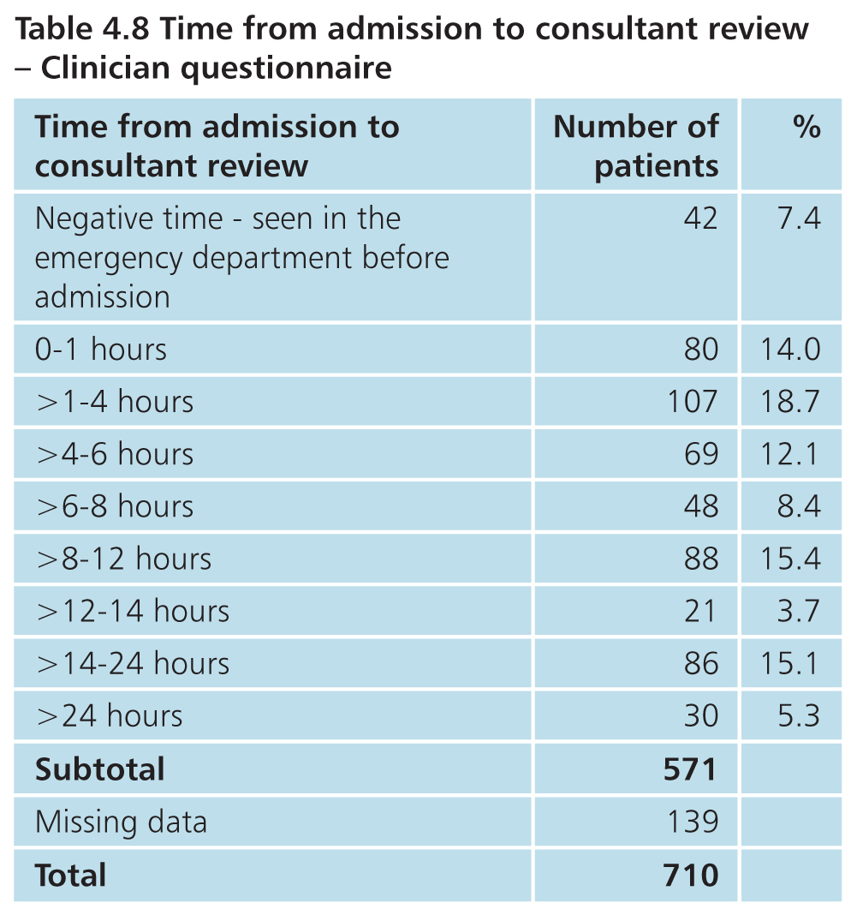
Inpatient care
20.4% > 14 hours
17.9% consultant review delayed according to Reviewers

Slide 62
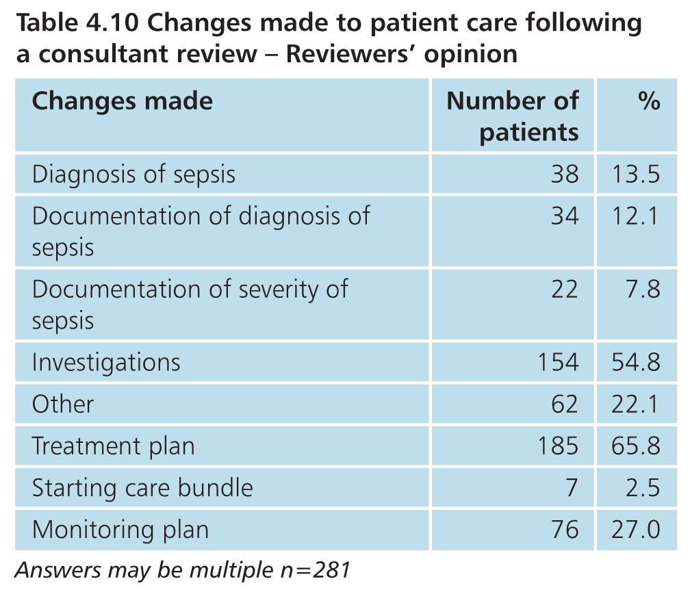
Inpatient care
Changes made following consultant review in 281/457 (61.5%)

Slide 63
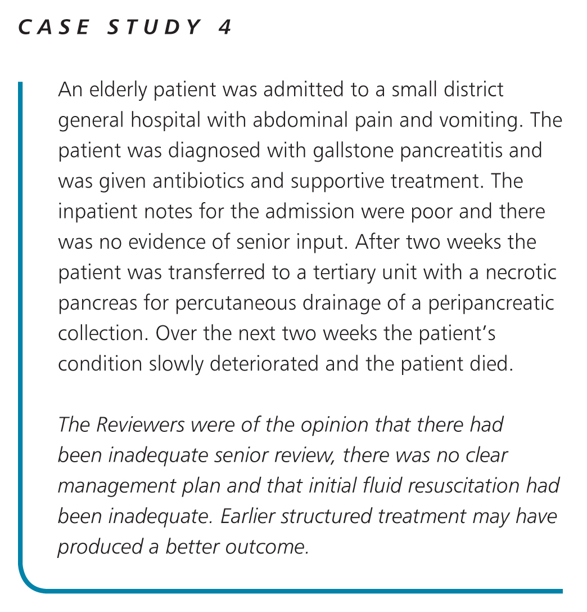

Slide 64
Hospital-acquired infection
Alex Goodwin

Slide 65
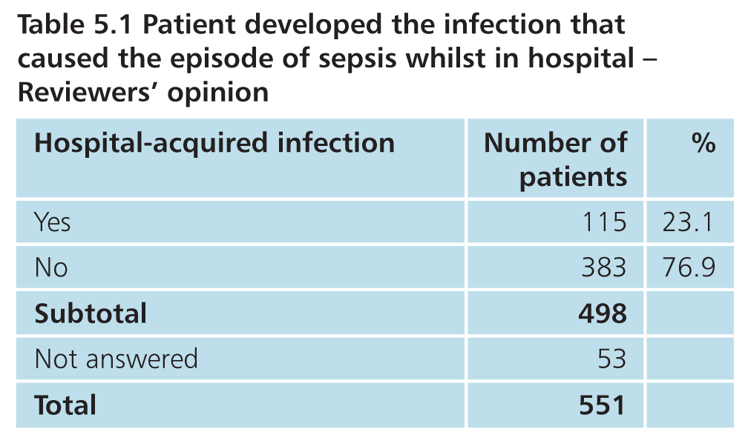
Inpatient care - source of infection

Slide 66
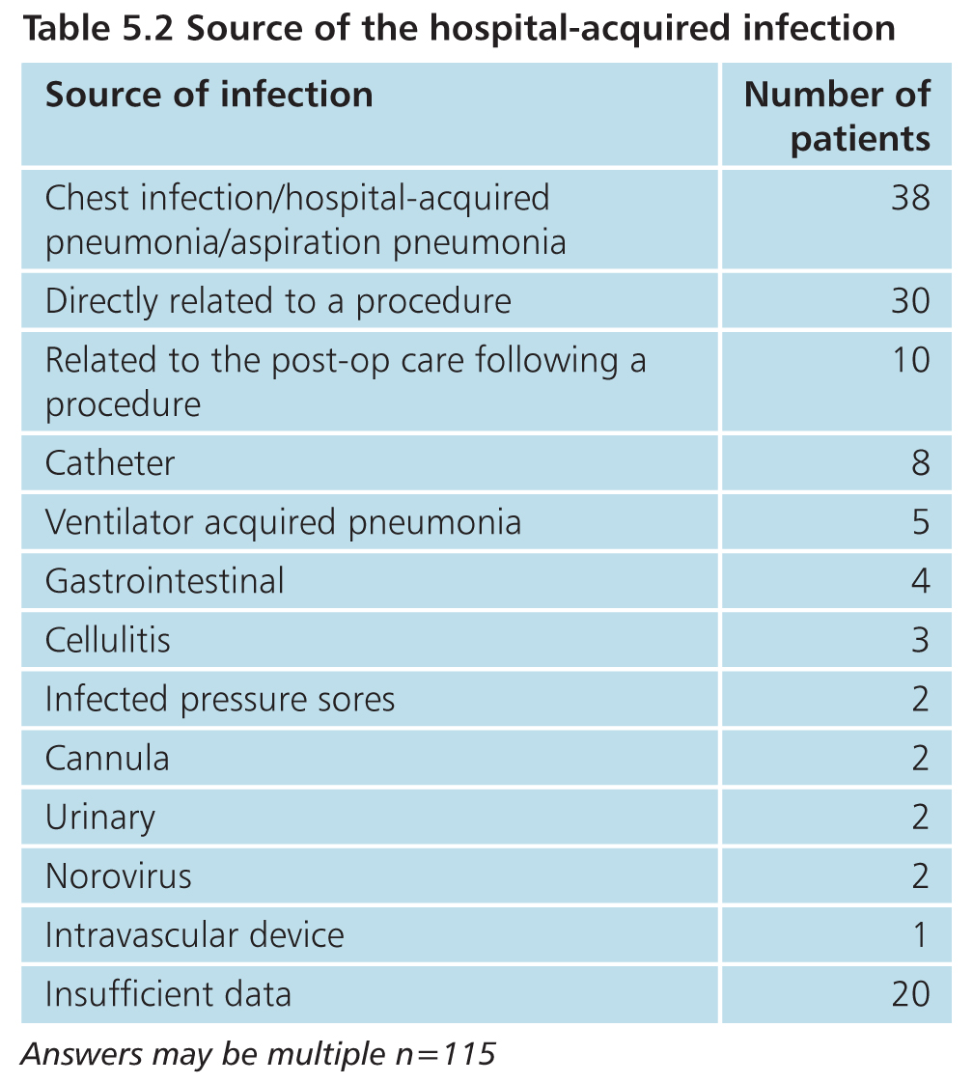
Inpatient care
Answers may be multiple, n=115

Slide 67

Inpatient care

Slide 68


Slide 69

Inpatient care

Slide 70
Diagnosis
Alex Goodwin

Slide 71

Inpatient care

Slide 72

Inpatient care

Slide 73

Inpatient care

Slide 74

Inpatient care
128/479 (26%) used screening tool/ EWS

Slide 75


Slide 76

Inpatient care
28%
30%
36%
31%
35%
55%

Slide 77

Inpatient care

Slide 78

Inpatient care
Blood cultures taken in 366/477 (77%)
fluid cultures in 48, tissue cultures in 43

Slide 79

Inpatient care
Blood gases taken in 375/509 (74%)

Slide 80

Inpatient care

Slide 81

Inpatient care
Where not timely, patient deteriorated in 51
Outcome affected in 20

Slide 82

Inpatient care
Room for improvement in fluid management in 203/447 cases

Slide 83

Inpatient care
Pathogen identified in 198/481 (41%)

Slide 84

Inpatient care

Slide 85

Inpatient care
Outcome affected in 43 cases

Slide 86
Inpatient care
Reviewers: patient started on sepsis care bundle following diagnosis: 135/434 (31%)
Clinician questionnaire: 207/318 (39%)

Slide 87
Inpatient care
 | With care bundle | Without care bundle
Delay in escalation | 9% | 26%
Delay in administration of administration of antimicrobials | 18.5% | 38%
Fluids delayed/ not received | 13% | 23%
Oxygen delayed / not received | 5% | 15%
Investigation of source of infection | 10% | 28%
Blood cultures not taken | 60% | 79.5%
Less than good documentation of sepsis | 19% | 33%
Blood gases not taken | 19% | 33%

Slide 88
Inpatient Care (organisational data)
224/226 (99%) acute hospitals had an antimicrobial policy
139/204 (68%) daily microbiology ward rounds on ICU
20/194 (10%) daily microbiology ward rounds on general medical wards
13/196 (7%) daily microbiology ward rounds on general surgical wards

Slide 89

Inpatient care
Appropriate antimicrobial in 472/571(91%)
Correct dose in 405/414 (98%)

Slide 90

Inpatient care
Regular review of antimicrobial therapy in 317/404 (78.5%)

Slide 91

Inpatient care
85.2%
79.7%
74.3%

Slide 92
Inpatient care
Opinion of treating clinician
Investigations to identify source omitted/delayed: 80/649 (12.3%)
Reviewer opinion
Investigations to identify source delayed:
101/505 (20%)
Investigations to identify source omitted:
113/495 (23%)

Slide 93
Inpatient care
Source of sepsis identified in 434/493 (88%)
Identified in appropriate timeframe in 340/421 (80%)

Slide 94

Comparison in identification of source
Emergency care

Slide 95

Inpatient care

Slide 96

Inpatient care

Slide 97

Inpatient care

Slide 98

Inpatient care

Slide 99

Inpatient Care (Organisational data)

Slide 100


Slide 101
Inpatient care
Room for improvement in initial management in 292/551 (53%)

Slide 102

Inpatient care

Slide 103

Inpatient care

Slide 104

Inpatient care
278 referred to critical care

Slide 105


Slide 106

Inpatient care

Slide 107

Inpatient care
Answers may be multiple; n=71

Slide 108

Inpatient care
Delayed discharge:
28/56 less than 1 week
11/56 1-2 weeks
17/56 more than 2 weeks

Slide 109

Inpatient care

Slide 110

Inpatient care

Slide 111

Inpatient care
GP was informed of admission in 222/294 (75.5%)

Slide 112

Inpatient care

Slide 113

Inpatient care

Slide 114

Inpatient care
Sepsis not recorded on the death certificate in 61/103 patients;
should have been in 48/61

Slide 115

Overall quality of care

Slide 116
Summary
Care less than good in 64% cases
Identification
Vital signs recording
Use of EWS
Communication between primary and secondary care
Treatment
Delay, Delay, Delay
Benefit of pathways, bundles and documentation
Antibiotic stewardship
Follow up
Recognition of complications and appropriate treatment
Information

Slide 117
Recommendations
All hospitals should have a formal protocol for the early identification and immediate management of patients with sepsis.
The protocol should be easily available to all clinical staff, who should receive training in its use. Compliance with the protocol should be regularly audited. This protocol should be updated in line with changes to national and international guidelines and local antimicrobial policies.

Slide 118
Recommendations
An early warning score, such as the National Early Warning Score (NEWS) should be used in both primary care and secondary care for patients where sepsis is suspected. This will aid the recognition of the severity of sepsis and can be used to prioritise urgency of care.

Slide 119
Recommendations
On arrival in the emergency department a full set of vital signs, as stated in the Royal College of Emergency Medicine standards for sepsis and septic shock should be undertaken.

Slide 120
Recommendations
In line with previous NCEPOD and other national reports’ recommendations on recognising and caring for the acutely deteriorating patients, hospitals should ensure that their staffing and resources enable:
a. All acutely ill patients to be reviewed by a consultant
within the recommended national timeframes (14 hrs post adm.)
b. Formal arrangements for handover
c. Access to critical care facilities if escalation is required; and
d. Hospitals with critical care facilities to provide a Critical Care Outreach service (or equivalent) 24/7.

Slide 121
Recommendations
All patients diagnosed with sepsis should benefit from
management on a care bundle as part of their care pathway.
The implementation of this bundle should be audited and reported on regularly. Trusts/Health Boards should aim to reach 100% compliance and this should be encouraged by local and national commissioning arrangements.

Slide 122
Thank you
www.ncepod.org.uk

