Slide 1


#AP
Dr Neil Smith
Dr Simon McPherson
Mr Derek O’Reilly

Slide 2

Acute pancreatitis
Management crosses many specialties
High mortality and morbidity
Recurrent admissions
Complex care and specialist input
Varied implementation of guidelines
Notes:
So why did NCEPOD undertake a study looking at acute pancreatitis.
The management of acute pancreatitis crosses many specialties and it has a high mortality and morbidity. Patients often have recurrent admissions. The care required is complex can require specialist input. In addition there is varied implementation of guidelines

Slide 3
Study population inclusion criteria
Patients aged 16 years or older who were coded for a primary diagnosis of acute pancreatitis and admitted to hospital between 1st January and 30th June 2014
An inpatient stay of three or more nights
Admission to critical care
Death in hospital
Notes:
As with all NCEPOD studies a study advisory group was put together to come up with the themes and objectives of the study, and the patient inclusion criteria.
After much discussion the following inclusion criteria decided.
The overall population was as follows: Patients aged 16 years or older who were coded for a primary diagnosis of acute pancreatitis and admitted to hospital between 1st January 2014 and 30th June 2014
To then look at a more severe group of patients, one of the following criteria had to be met
An inpatient stay of three or more nights, Admission to critical care, Death in hospital

Slide 4
Data collection
Patient identifier spreadsheet
Clinician questionnaire
Case notes/peer review
Organisational questionnaire
Notes:
There were 4 sources of data for the study.
A patient identifier spreadsheet which was completed by our local reporters, that are our contact in each hospital. As well as basic demographic information about the patient, it also collected details on length of stay, outcome and whether or not the patient was admitted to critical care. We were also provided with details of the consultant responsible for the patient.
The clinician questionnaire was sent to the consultant responsible for the patient at the time of discharged, with the caveat that they liaise or pass on the questionnaire to a more appropriate consultant if this was necessary.
Photocopied case notes for each patient included in the study for peer review by the case reviewers
Finally an organisational questionnaire was sent out to each hospital that admits patients with AP

Slide 5
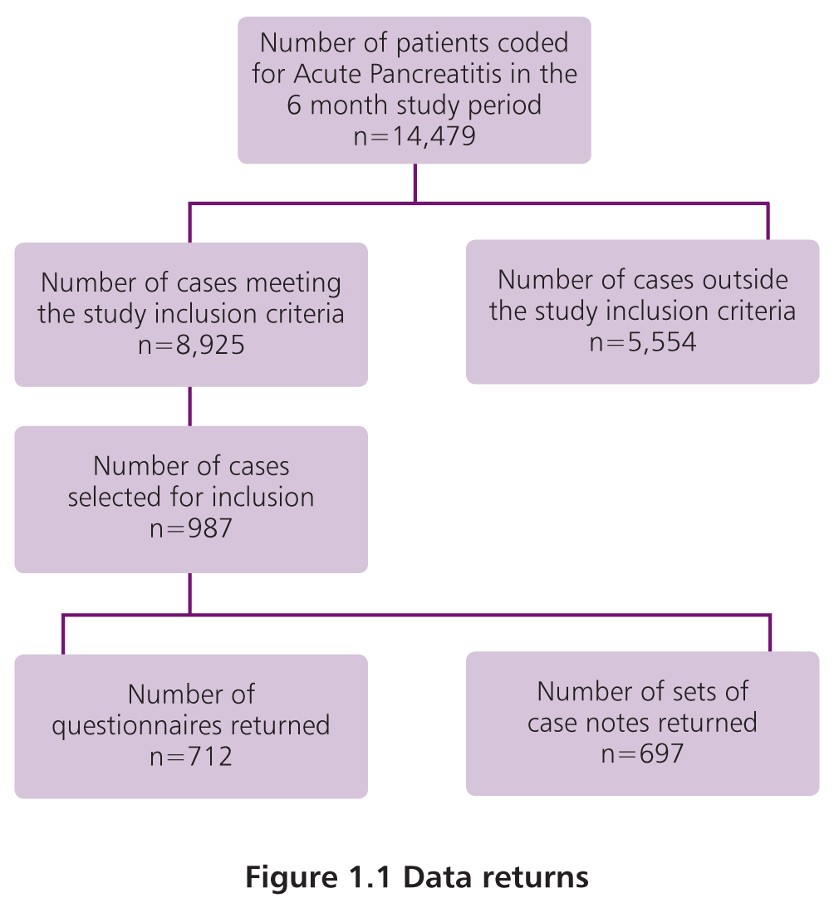
Data returns
Notes:
Approximately 14500 cases were coded as acute pancreatitis during the 6 month study period. 8925 met the study inclusion criteria. To limit study fatigue and strain resources, we sampled up to 5 cases per hospital, which resulted in 987 cases being selected for questionnaire completion and peer review.
We realise that selecting 5 cases per hospital does bias the study towards lower volume non specialist hospitals, however the vast majority of patients will start off at non specialist hospitals.
The data presented in the report is aggregated data for the 712 completed questionnaires returned and for 418 sets of case notes that were peer reviewed. The denominators will change throughout the report depending on the source of the data and completeness of answers.

Slide 6
Study aim
To identify remediable factors in the quality of care provided to patients treated for acute pancreatitis
Notes:
The overall aim of the study was to identify remediable factors in the quality of care provided to patients treated for acute pancreatitis

Slide 7
CAUSE & PATIENT CHARACTERISTICS

Slide 8
Cause of AP – study population
Gallstones 46.5% (322/692)
Alcohol excess 22% (152/692)
Post-ERCP 4% (28/692)
No cause 17.5% (121/692)
Notes:
The clinician’s caring for the patients identified the cause of AP in their questionnaire as ...Slide data.
Truly idiopathic AP should account for less than 10%. It may be argued that some of these patients would have additional investigations as an OP which would subsequently determine the underlying cause of their AP but it is unlikely that this would be the case for close to half of the patients with no cause identified at the time of discharge, particularly as the number of patients with planned investigations post discharge was low.
Determining the cause early at the time of the first presentation with AP allows early direction of therapy and prevents recurrent AP admissions

Slide 9
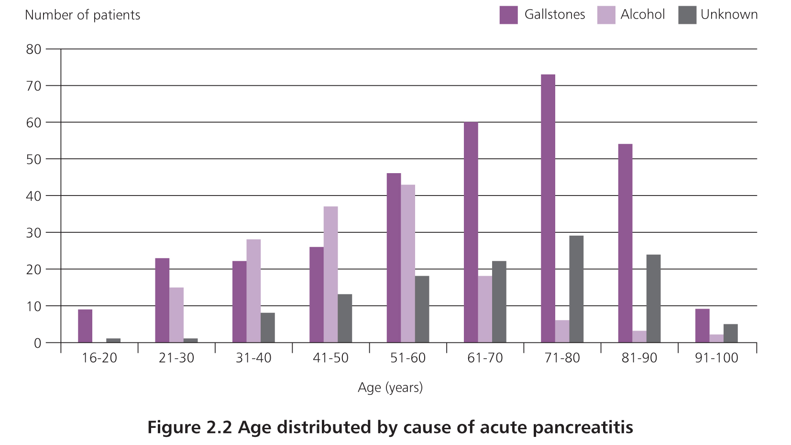
Cause of AP by age
Median age = 61 years (17-99)
55% male
Notes:
Slide showing the cause of AP [gallstones, alcohol and unknown] by age. Slide data. Gallstones were the commonest cause in the under 30s and those over the age of 51. Alcohol related AP was the commonest cause in those aged 31-50 with median age for alcohol related AP approx 20 years younger than those gallstone or unknown cause.

Slide 10
ADMISSION

Slide 11
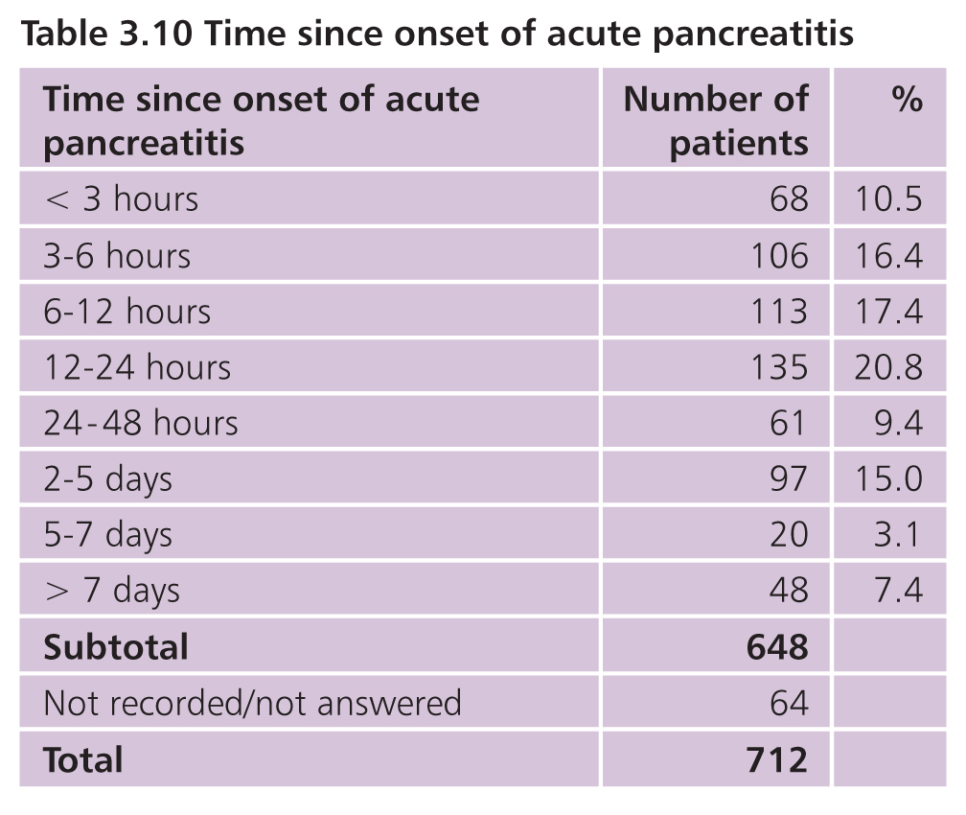
Initial presentation
98.3% (687/699) Emergency
79% (551/698) Emergency department
21% (147/698) Directly to a ward or level 2/3
Notes:
Almost all patients were admitted as an emergency. The majority of the 1.7% who were not had post ERCP AP. Slide data. 56% had symptoms for > 12 hours before their admission. Presentation after 24 hours was equally likely in first presentations and those with prior AP. Despite the fact that these pts will have received delayed fluid resuscitation and oxygenation they did not have a higher mortality or more critical care admissions.

Slide 12
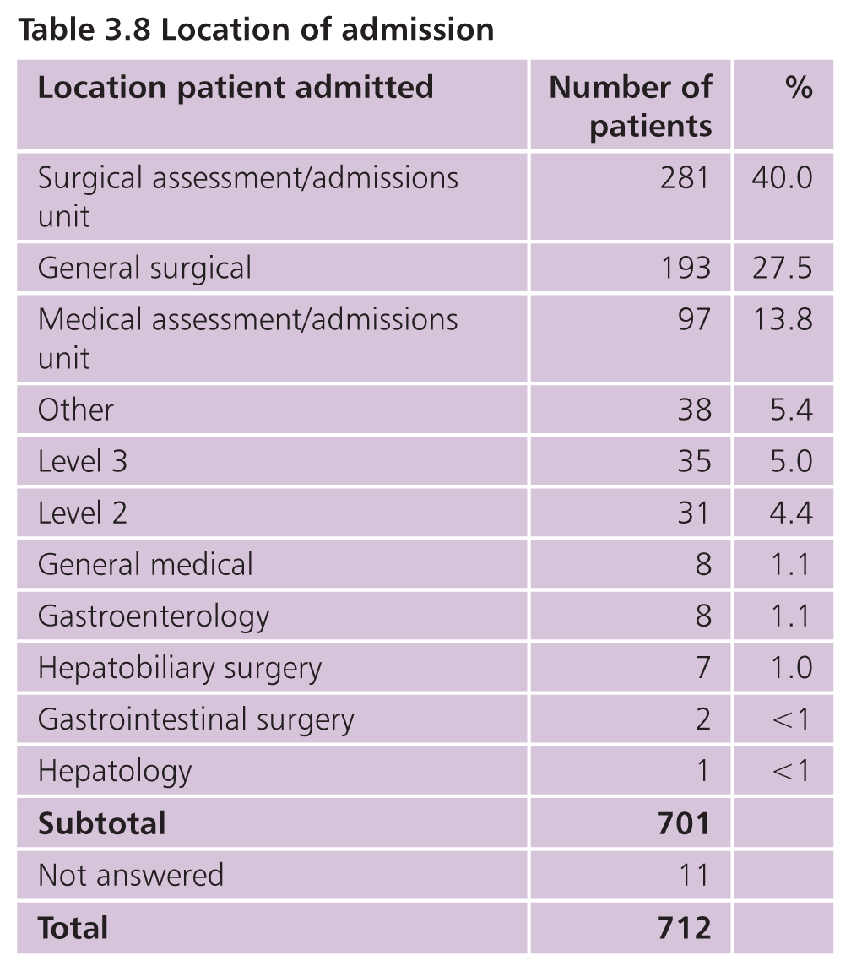
Ward admission
68.9% (483/701) SAU or surgical ward
9.4% HDU/ITU
Notes:
Surgical teams led the care for the majority of the patients with 68.9% admitted to a surgical ward or surgical assessment unit
9.4% were admitted directly to a level 2 or 3 bed.

Slide 13
Early warning scores
Notes:
EWS are simple track and trigger systems to detect the severely ill patient at presentation and to subsequently identify any deterioration in the patient’s condition . They should be used in all acutely ill patients, including those with AP. NCEPOD first recommended their introduction in the 2005 report “ An Acute Problem”.

Slide 14
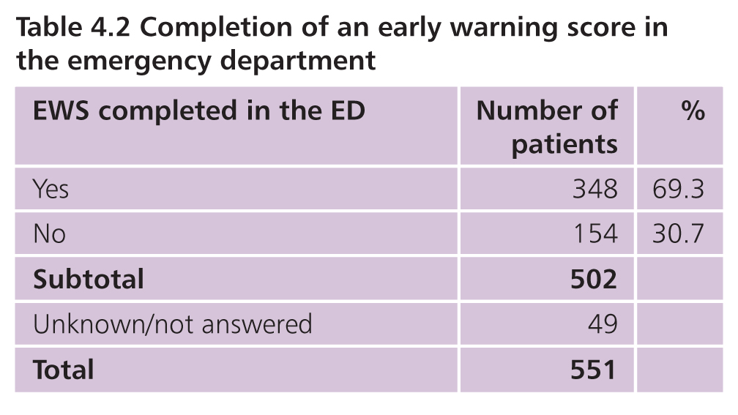
EWS in the emergency department
Notes:
The clinicians caring for the patient was asked if there was evidence of an EWS performed in the ED. In 30.7% they could find no evidence of this.

Slide 15
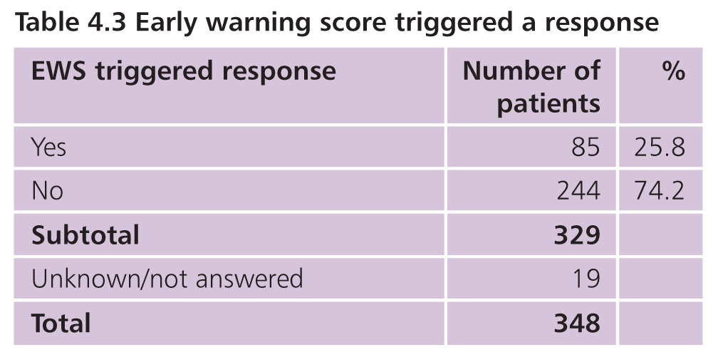
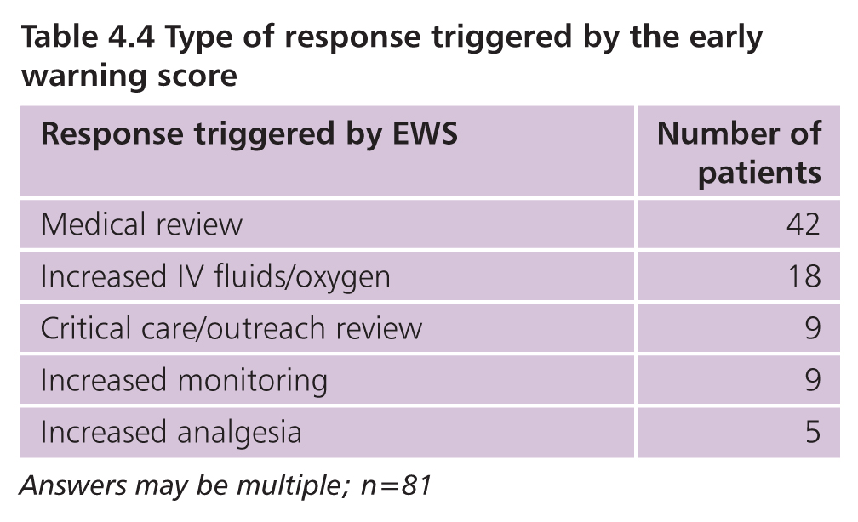
EWS in the emergency department
Notes:
Where a EWS was used in the ED the case reviewers considered it had triggered a response in 25.8% . The commonest was earlier medical or critical care review but improved resuscitation, monitoring and pain control all occurred.

Slide 16
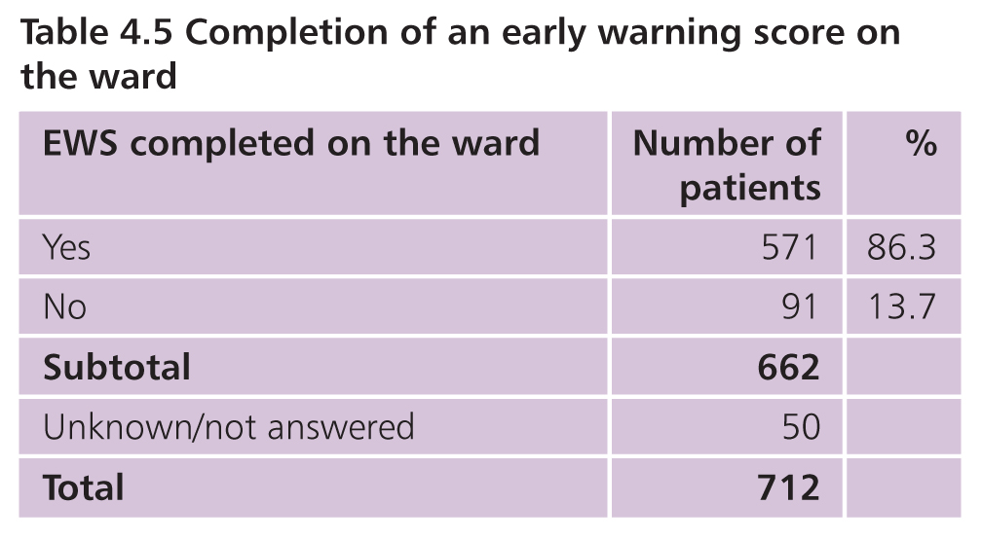
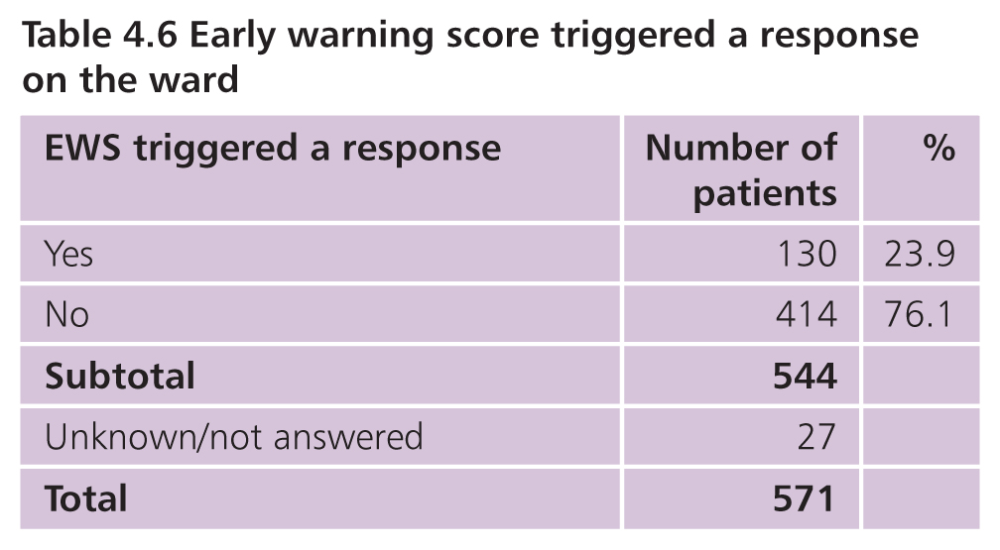
EWS on the ward
Notes:
The patient’s condition was more likely to be formally tracked on the ward with 86% having an early warning score. Where this was performed the percentage of patients where this triggered a response was similar to that for ED EWS.

Slide 17
Early warning scores
65.1% (313/481) ED and ward EWS
8.7% (42/481) no EWS either location
8% (22/285) different EWS
Notes:
Slide data.
The use of different EWS within and across organisations can result in a lack of consistency in the detection of severe illness and deterioration.
In 2012 the Royal College of Physicians (London) recommended standardising the range of EWS used across the NHS to a single NEWS.

Slide 18
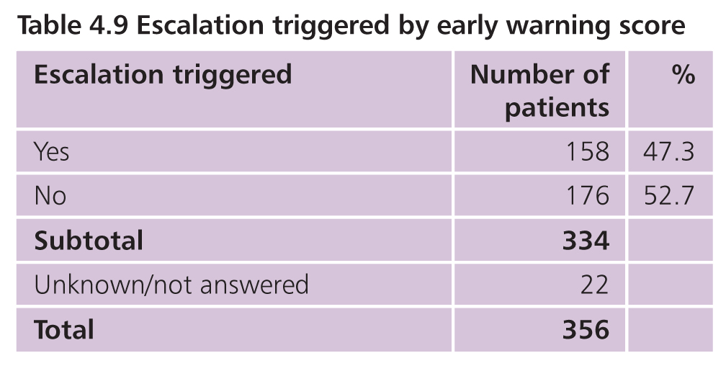
Escalation of care
93% (356/383) on going use of EWS
Most common
Critical care review
Other specialty review
Notes:
The case reviewers found that 93% had ongoing use of EWS during their admission. The impact of this was an escalation of care in 47%, most commonly critical care review or review by another medical or surgical speciality.

Slide 19
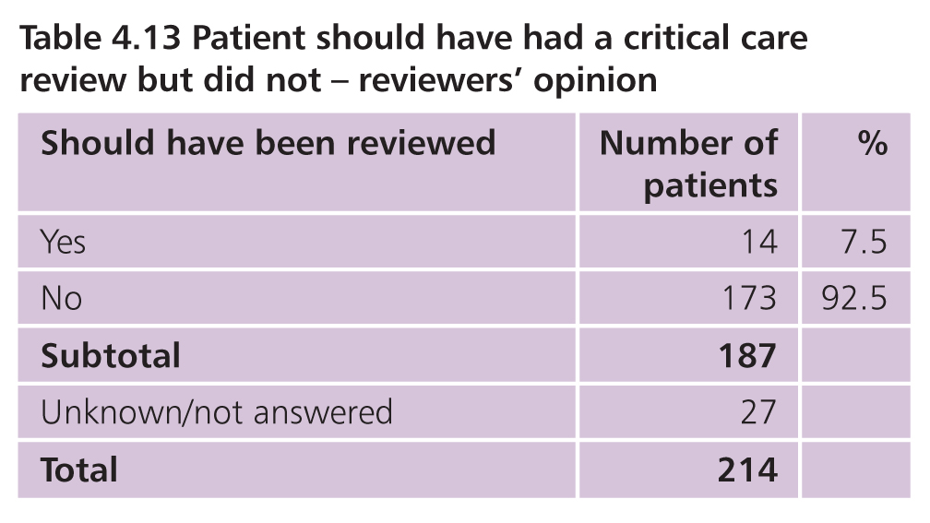
Escalation of care
13% (15/115) delayed review
Notes:
Whilst the study found that most patients did receive appropriate escalation in care it was not timely in 13% and a further ,7.5% should have had a critical care review but did not.

Slide 20
Recommendation 4 - early warning scores
An early warning score should be used in the ED and throughout the patient’s hospital stay to aid recognition of deterioration. This should be standardised within and across all hospitals.
NCEPOD supports the use of NEWS to facilitate standardisation

Slide 21
Recommendation 5 - early warning scores
All acute hospitals should have local arrangements to ensure an agreed response at each NEWS trigger level including:
Speed of response
Clear escalation policy which ensures an appropriate response 24/7
Seniority and clinical competencies of the responder
Appropriate setting for on-going acute care and timely access to high dependency care if required
Frequency of subsequent monitoring

Slide 22
Oxygenation & fluid management
Notes:
Maintenance of adequate oxygenation and circulating volume decreases the risk of end-organ damage and is one of the main goals of initial management.

Slide 23
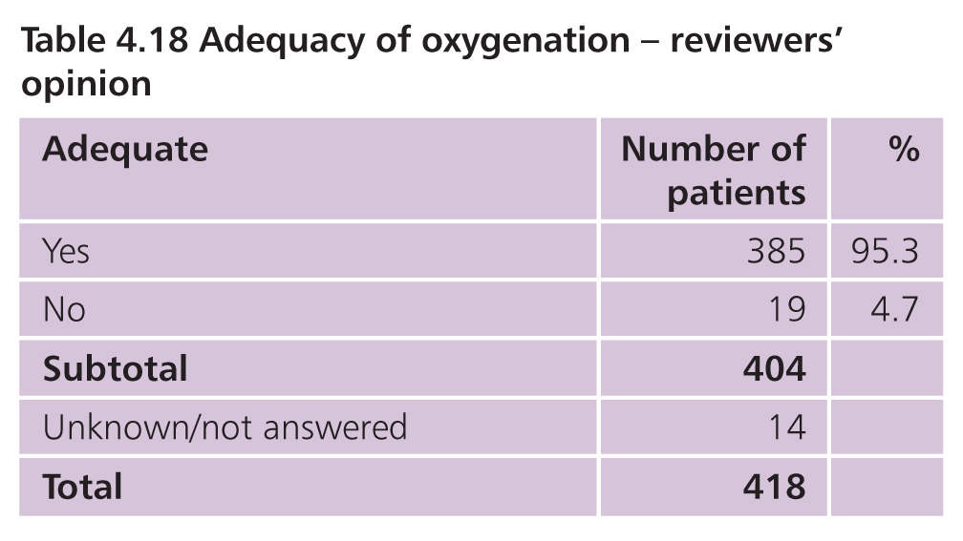
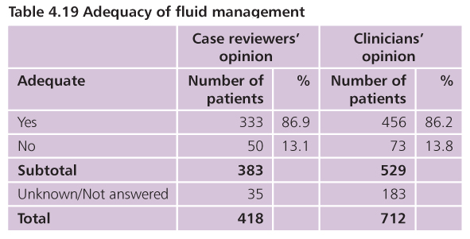
Oxygenation and fluid management
Notes:
Slide data – reviewers 13.1% . Clinicians answered the same question regarding the patients they had cared for and were equally critical of fluid management

Slide 24
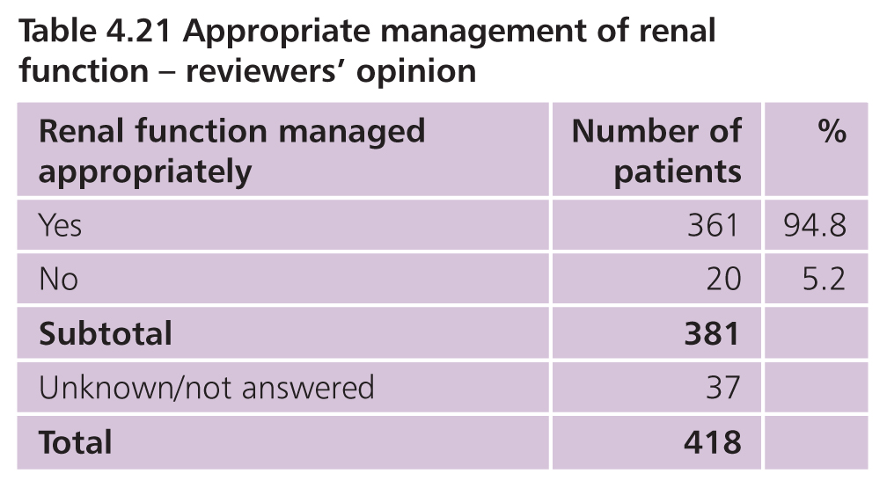
Acute Kidney Injury
21.7% (148/681) AKI
6 avoidable
Notes:
Slide data
Deficiencies in renal management included insufficient IV fluids, lack of appropriate oxygenation and failure to stop nephrotoxic drugs

Slide 25
imaging
Notes:
In the 2012 International Association of Pancreatology guideline 6/38 recommendations concern diagnostic imaging

Slide 26
Imaging
Establish
Diagnosis when clinical/biochemical doubt
9.3% (39/418)
Cause
Severe AP
Confirmation of severity
Diagnose complications
Guide treatments
Monitor resolution
Notes:
In study 9.3% (39/418) required imaging to make the diagnosis

Slide 27
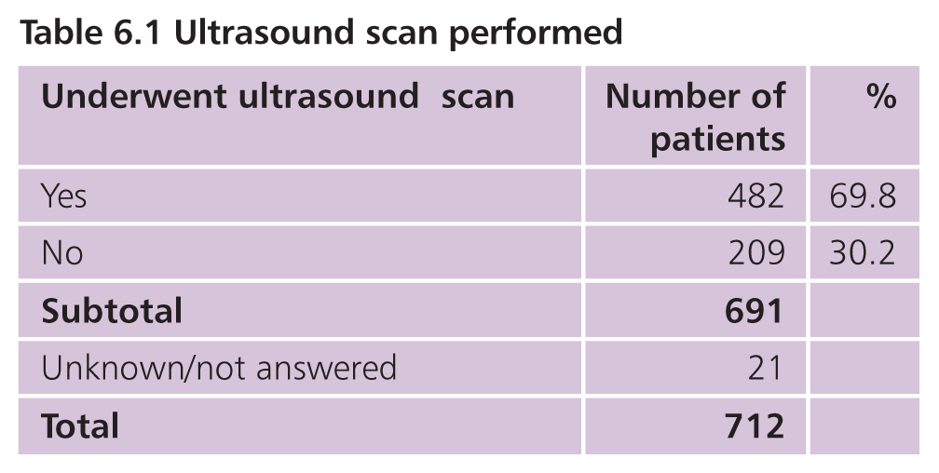
Ultrasound
Notes:
RUQ ultrasound is recommended during the index admission with AP by the IAP guideline

Slide 28
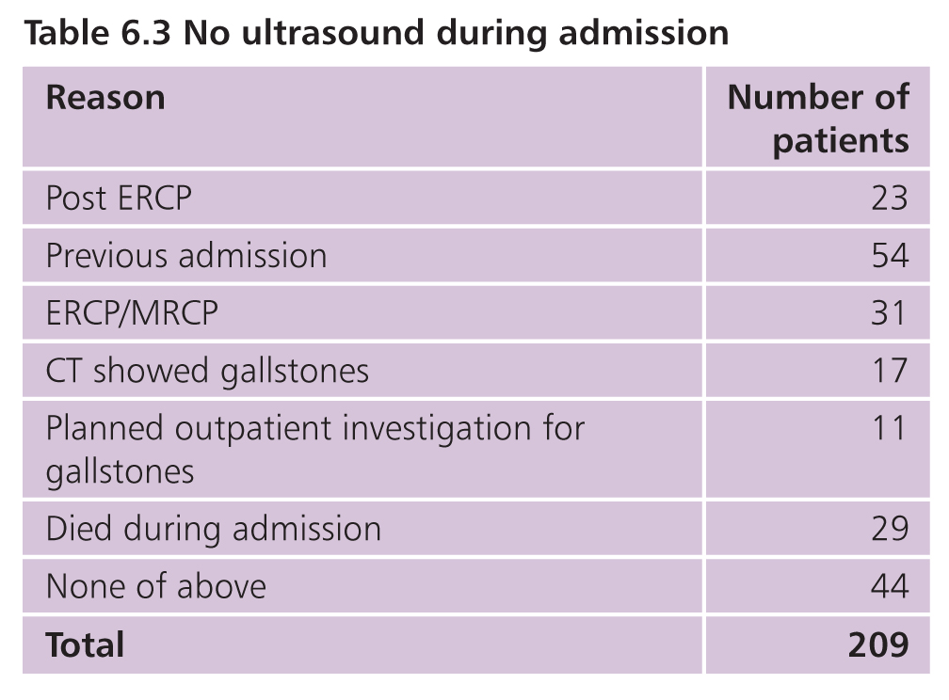
No ultrasound
21% (44/209) no reason for no US
24/44 alcohol-related AP
Notes:
In those who did not have an US we looked at possible justification for that. Reasons included post ERCP, already known gallstones from other imaging , other investigations to look for gallstones planned and death during the index admission.
54/209 patients had a previous AP admission. Clinical teams may have known or presumed that gallstones had been excluded previously, but not known as those notes were not available..
This leaves a best 21% of patients with an inappropriately omitted US.
24/44 with no US were presumed to have alcohol related AP with no exclusion of other possible causes

Slide 29
Recommendation 9 - gallstones
Gallstones should be excluded in ALL patients, including those thought to have alcohol-related AP, as gallstones are common in the general population.
Abdominal US is the minimum that should be performed.
Notes:
Our recommendation is that

Slide 30
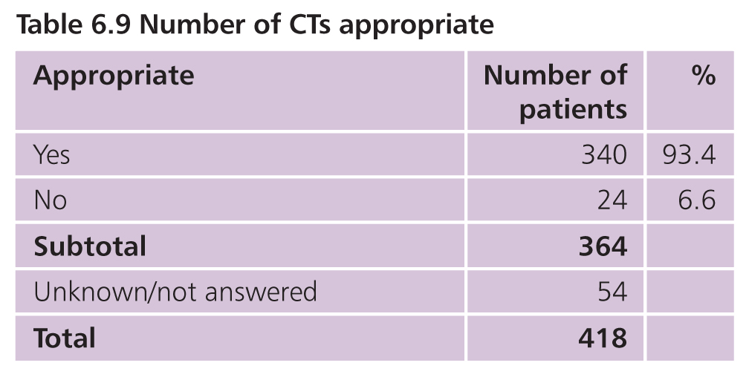
CT scans
60.1% (416/692) at least one CT
17.9% (73/408) necrotising pancreatitis
12.7% (52/408) APC or pseudo-cyst
13 infected collections
Notes:
Slide data
The SAG were concerned that there may be over use of CT in AP resulting in harm from unnecessary irradiation and increased risk of contrast nephrotoxicity.
The case reviewers considered the number of CTs appropriate in all bar 6.6% . These were equally split between patients having too many and those having too few CTs. The reality of practice seems to be that CT is used responsibly.

Slide 31
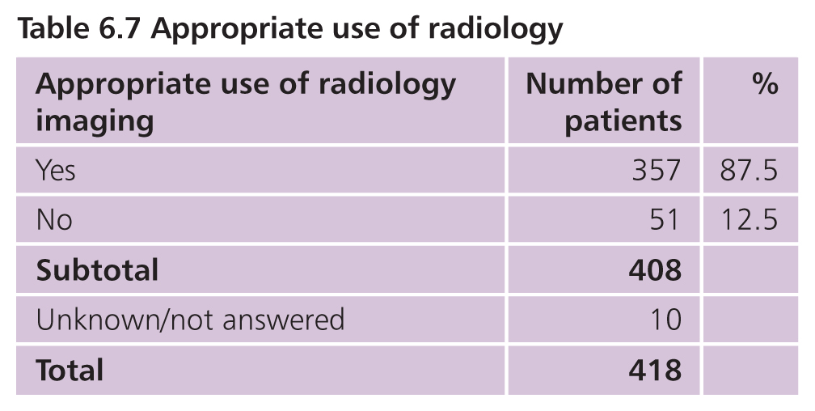
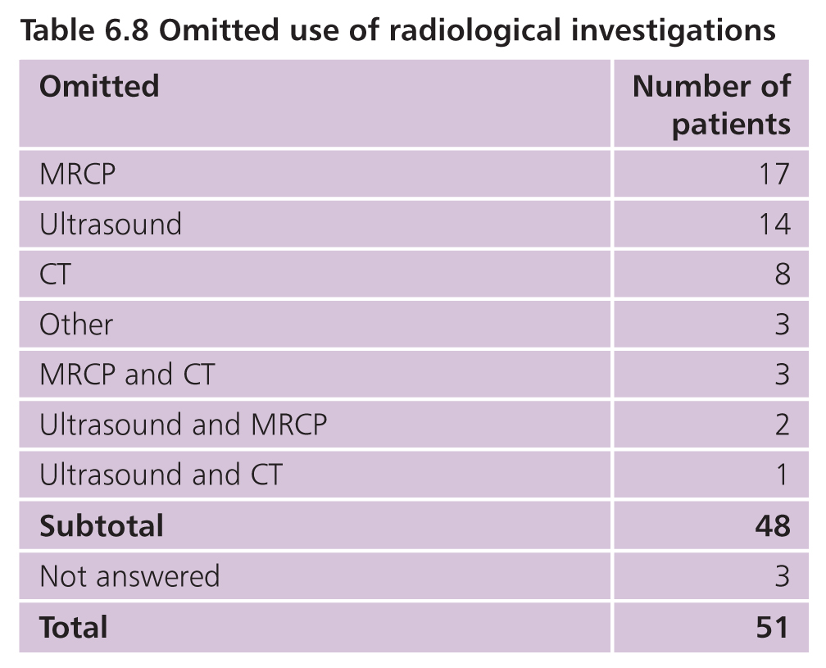
Omitted imaging
Notes:
The use of all radiological imaging was considered to be appropriate in 87.5%.
The case reviewers considered that 48 patients had one or more investigation omitted. The commonest was MRCP at 22/48

Slide 32
Recommendation 17 - AP of unknown cause
After excluding the commoner causes of AP those in whom the cause remains unknown should undergo MRCP and/or endoscopic ultrasound to detect micro-lithiasis, neoplasms and chronic pancreatitis as well as rare morphological abnormalities. A CT of the abdomen should also be considered.
Notes:
Our recommendation is that

Slide 33
Antibiotic use & misuse
Notes:
The role of antibiotics in acute pancreatitis, once controversial, is now very clear.
Antibiotics are for treating infections and not recommended by the IAP for the prophylaxis (prevention) of infectious complications in acute pancreatitis
Despite this, 61% of patients in this study, received antibiotics.

Slide 34
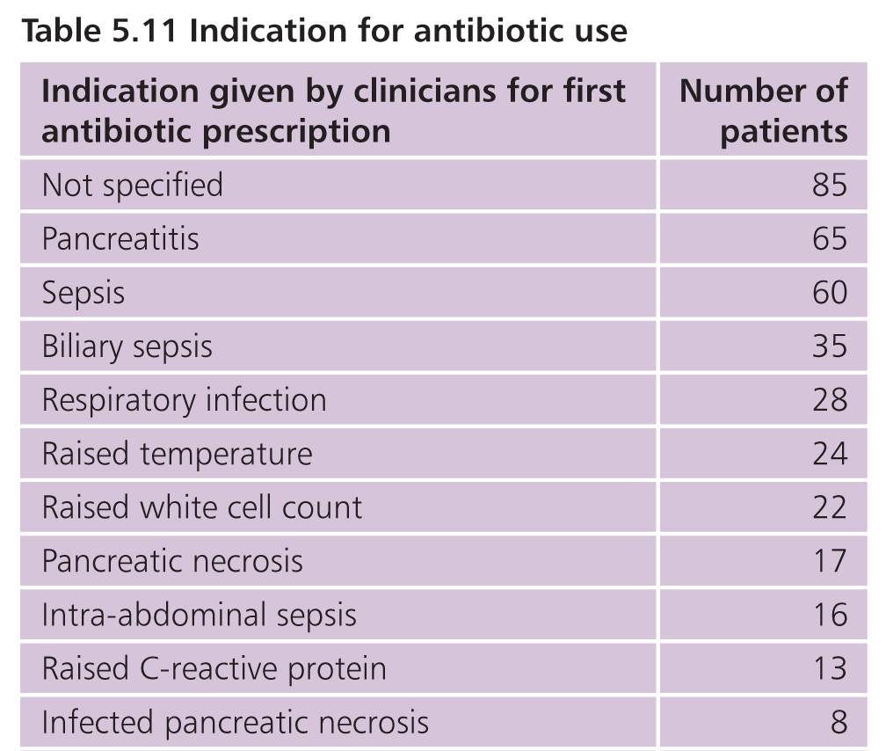
Indication for antibiotic use
Notes:
But clearly, confusion on this issue still remains.
When we asked clinicians why they had prescribed antibiotics, their commenest answer was ‘I don’t know’ ie. Not specified.
The second commonest reason was because the patient had “pancreatitis”!
Clearly there are valid reasons for prescribing antibiotics in AP and documented, biliary, respiratory and UTIs were recorded.
However, it is concerning that individual items such as “Raised temperature; raised WCC; and raised CRP” and “pancreatic necrosis” per se, are considered indications for antibiotic prescription in this condition.

Slide 35
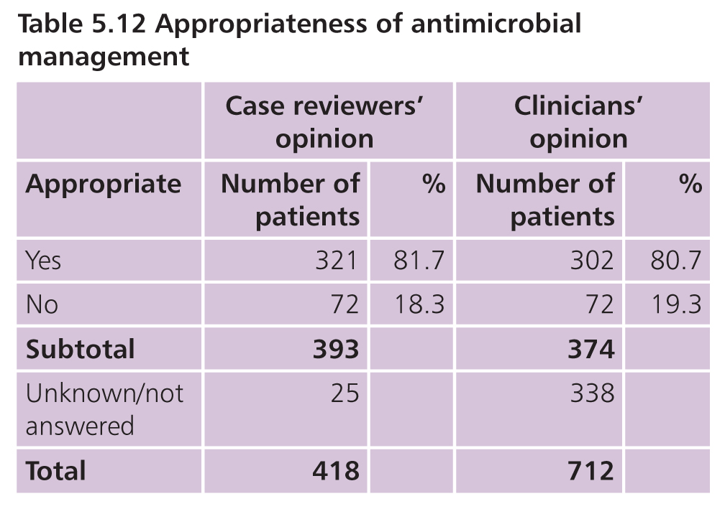
Appropriateness of antibiotics
Notes:
We asked the case reviewers the clinicians, overall, how appropriate they thought the antibiotic prescription was; and they came up with a very similar proportion: in about one fifth of cases.

Slide 36
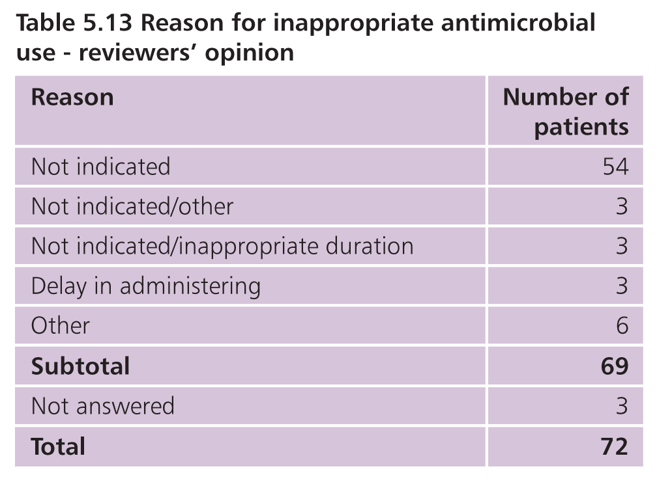
Inappropriateness of antibiotics
Notes:
And the reason that they considered antibiotic usage inappropriate in almost one-fifth of case was almost universally because it was “not indicated”

Slide 37
Recommendation 7 - antibiotic prophylaxis
Antibiotic prophylaxis is not recommended in acute pancreatitis.
All healthcare providers should ensure that antimicrobial policies are in place including prescription, review and the administration of antimicrobials as part of an antimicrobial stewardship process.
These policies must be accessible, adhered to and frequently reviewed with training provided in their use.
Notes:
Antibiotic overuse causes harm, especially in encouraging the emergence of resistant organisms.
Therefore we strongly endorse the IAP recommendation against antibiotic prophylaxis and stress the importance of the concept of antibiotic stewardship (as defined by NICE) within each institution.

Slide 38
nutrition
Notes:
Nutrition is an essential component of treatment in AP

Slide 39
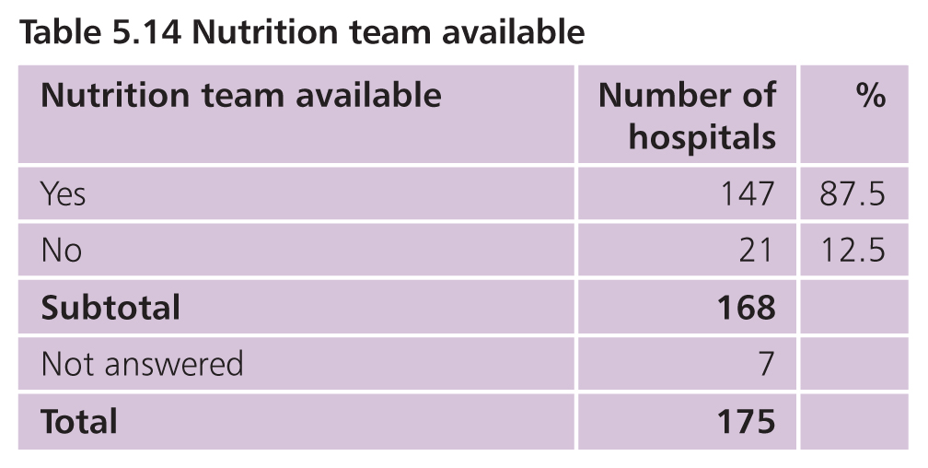
Nutrition team availability
Notes:
We asked each organisation if they had a nutrition team on site; and 87% said that they had.
This is a piece of good news; when we asked that question in the 2010 NCEPOD study on PN “A mixed Bag”, the corresponding figure was only 60%, so clearly, there have been organisation improvements during that time.

Slide 40
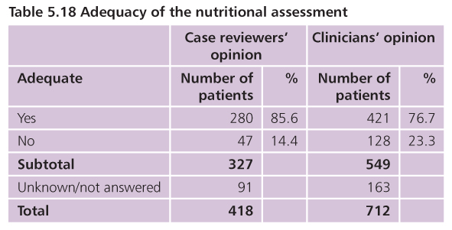
Nutritional assessment
Notes:
However, we also identified some important opportunities for improvement.
NICE guidelines state that All patients should be screened for malnutrition on assessment & this repeated weekly, for example by using the MUST tool
This process was deemed deficient in 14 to 23% of cases, either because it was delayed or not done at all.

Slide 41
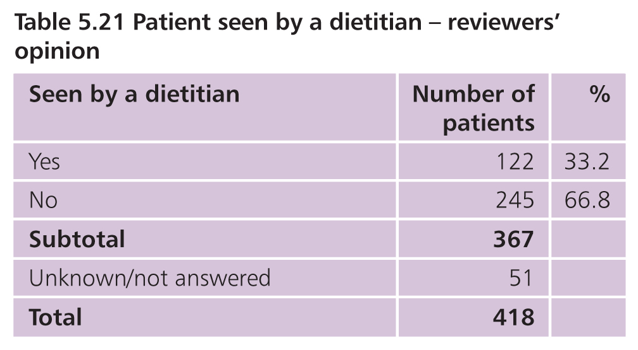
Dietitian involvement
Notes:
One third of patients in this cohort were referred to a dietitian…

Slide 42
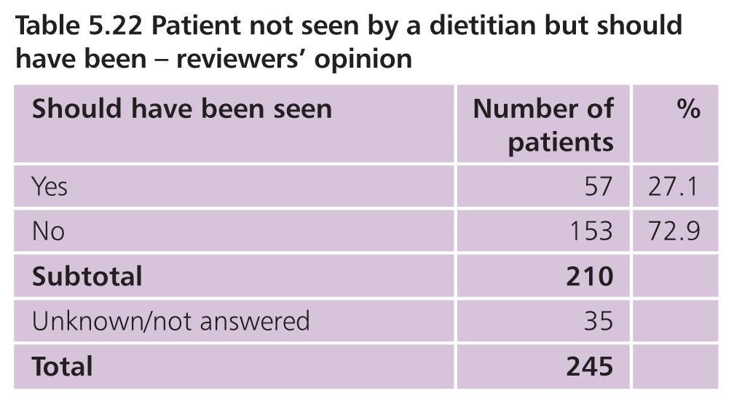
Dietitian involvement
Notes:
…but of those who were not, the reviewers determined that 27% of them should have been.

Slide 43
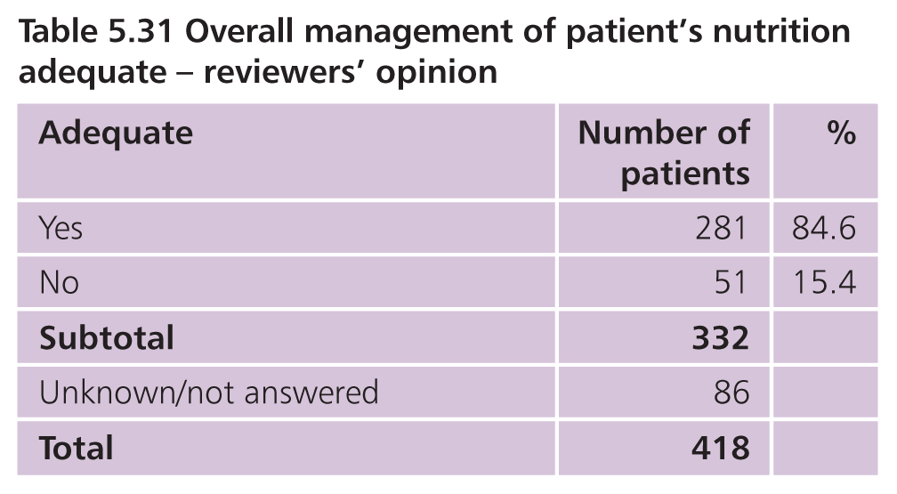
Overall nutrition management
Notes:
Overall, considering nutritional assessment, dietitian and nutritional team referral and provision of supplemental nutrition, in 15% of cases this was deemed inadequate. Clearly, this represents an area where we could do better.

Slide 44
Recommendation 8 - nutritional support
All patients admitted to hospital with acute pancreatitis should be assessed for their overall risk of malnutrition.
This could be facilitated by using the Malnutrition Universal Screening Tool (MUST) and provides a basis for appropriate referral to a dietitian or a nutritional support team and subsequent timely and adequate nutrition support.
Notes:
Our recommendation stresses the importance of early nutritional assessment and subsequent appropriate referral to a dietitian/nutritional team for nutritional support and the fact that the MUST tool facilitates this.

Slide 45
The problem of recurrent admissions
Notes:
This Report is called “Treat the Cause” for a very good reason; One in five patients in this study (143/694) were repeat admissions.

Slide 46
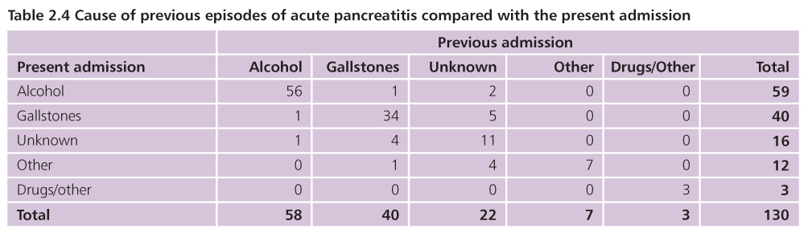
Previous admissions
Notes:
Moreover, they were readmissions for the same reasons (in 93% of cases).
56 readmitted with alcohol related AP and 34 with gallstone AP.
So why is this?

Slide 47
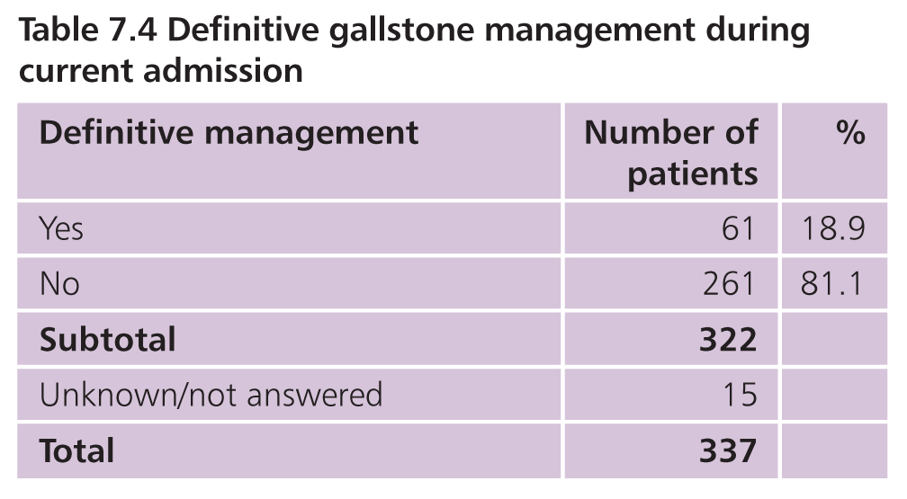
Definitive gallstone management
Notes:
The first reason is that patients with gallstone pancreatitis are not getting their gallbladder removed during the same admission, as recommended by the IAP. This only occurred in 18% of cases.

Slide 48
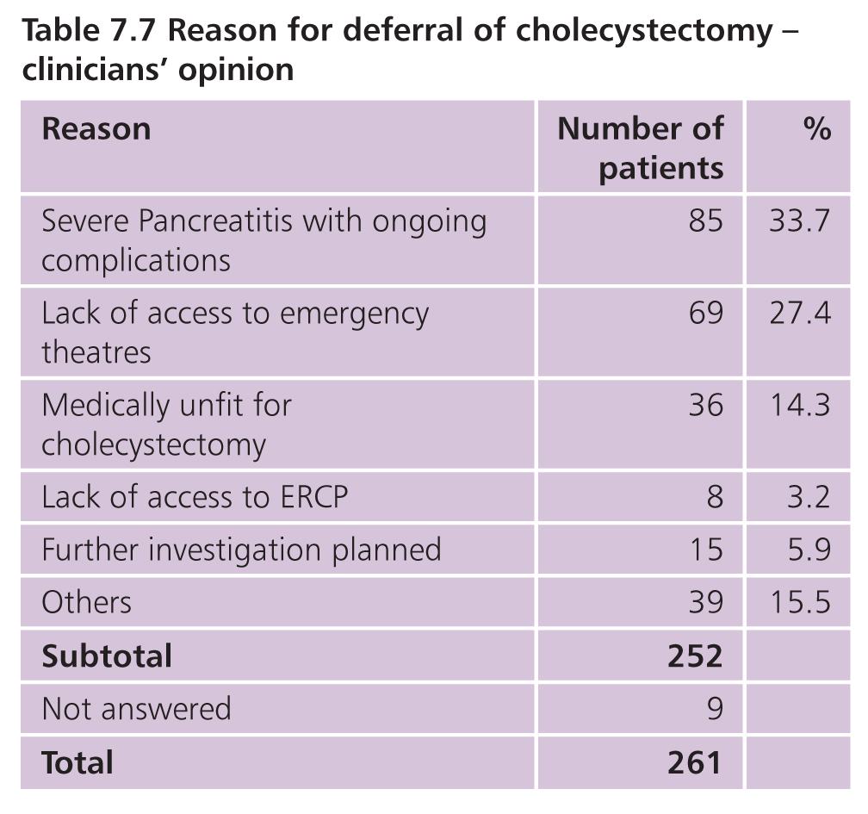
Deferral of cholecystecomy
Notes:
Of course there may be many valid reason why this does not occur e.g: on-going severe AP, those who are medically unfit etc.
But “lack of access to emergency theatres” is not a valid reason to defer cholecystectomy, and this was quoted as the reason in 69 (27%) of cases.

Slide 49
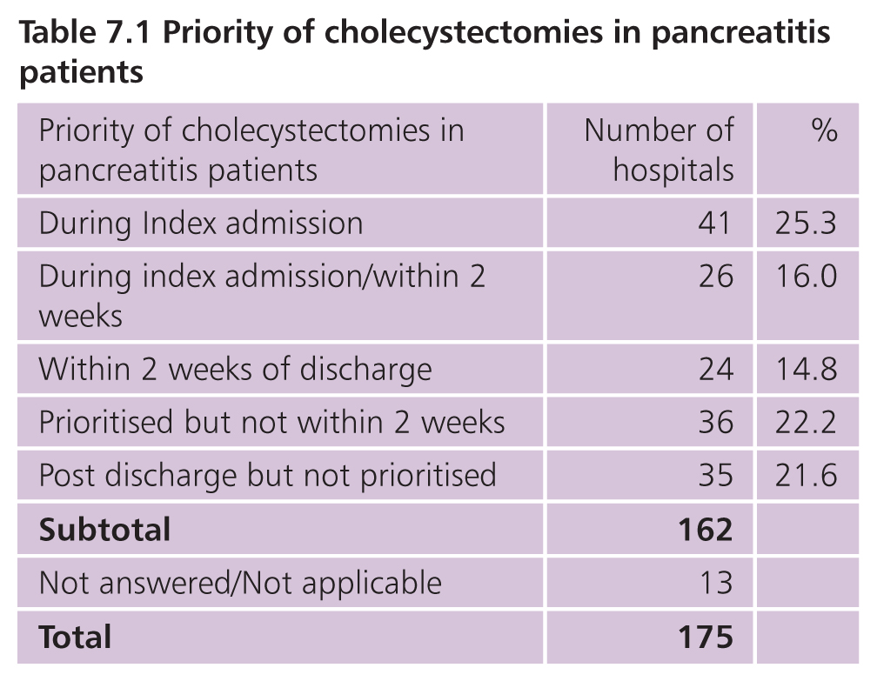
Availability of cholecystectomy
Notes:
The answer to the question why emergency theatre access for these patients is not available, is explicable when we turn to the questionaires returned by each organisation: while about half have a policy for doing this on the index admission or within two weeks, 20% stated that they did not prioritise cholecystectomy for AP patients within 2 weeks and another 20% said that they did not prioritise it at all!

Slide 50
Recommendation 10 - gallstone pancreatitis
For those patients with an episode of mild acute pancreatitis, early definitive surgery should be undertaken, either during the index admission, as recommended by IAP, or on a planned list, within two weeks.
For those patients with severe acute pancreatitis, cholecystectomy should be undertaken when clinically appropriate after resolution of pancreatitis.
Notes:
Therefore, our recommendation is an endorsement of the IAP view that, for mild AP, cholecystectomy should be performed on the index admission or, if the patient can be discharged, within 2 weeks.
For those with severe AP, clearly this depends on resolution of the disease and patient fitness.

Slide 51
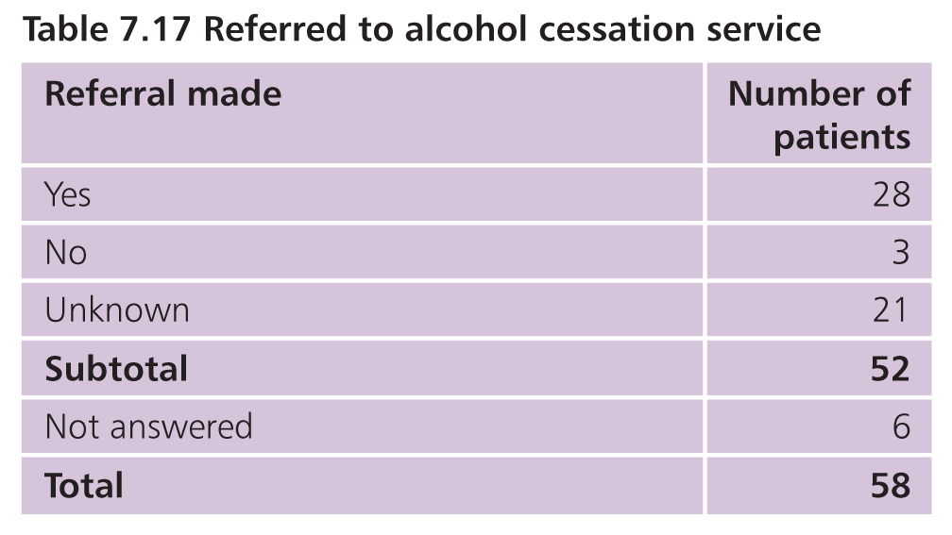
Alcohol-related acute pancreatitis
Notes:
The second commonest cause of AP was alcohol. And with interventions and support, this too is a treatable and preventable cause.
Despite this, in considering those with recurrent AP due to alcohol, the reviewers could only determine that a referral to an alcohol support/cessation service had occurred in about half of cases.

Slide 52
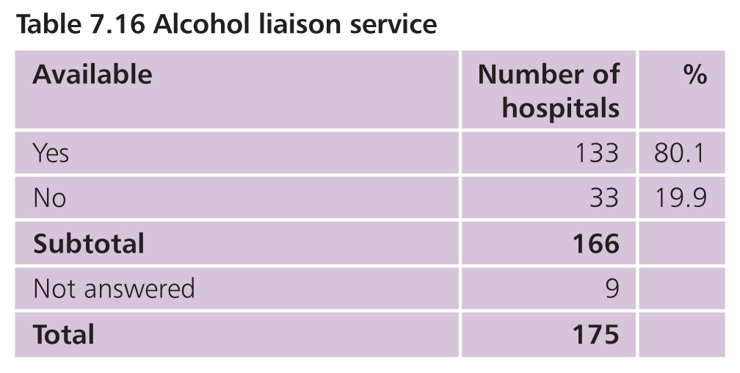
Alcohol liaison service
Notes:
And part of the reason for this must be that only 80% of hospitals have such a service.
This is certainly an opportunity for improvement. As clinicians we should stop simply responding to the consequences of alcohol misuse but deal with the underlying cause, that is, the alcohol.

Slide 53
Recommendation 13 - alcohol support
All patients with suspected alcohol-related acute pancreatitis should be discussed with the hospital alcohol support service at every admission.
Efforts to deal with this underlying cause of acute pancreatitis should equal those of gallstone acute pancreatitis.
Future clinical guidelines on acute pancreatitis should incorporate this.
Notes:
Recommendations as above.
This is a challenge to the IAP and NICE to incorporate these recommendations into future guidelines/revisions.

Slide 54
networks for the treatment of complications
Notes:
As the treatment of AP becomes increasingly complex and specialised, there is a need for regional centres to provide the full range of interventions and treatments that may be required.

Slide 55
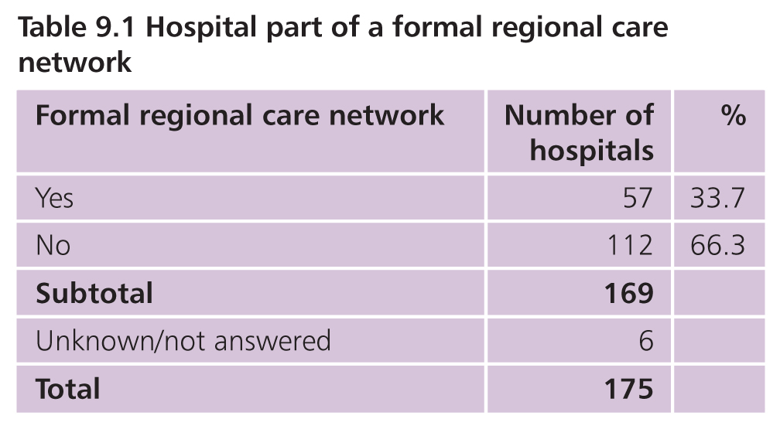
Formal network of care
Notes:
This currently doesn’t exist: only 33% of hospitals declared that they were part of a formal network for AP.

Slide 56
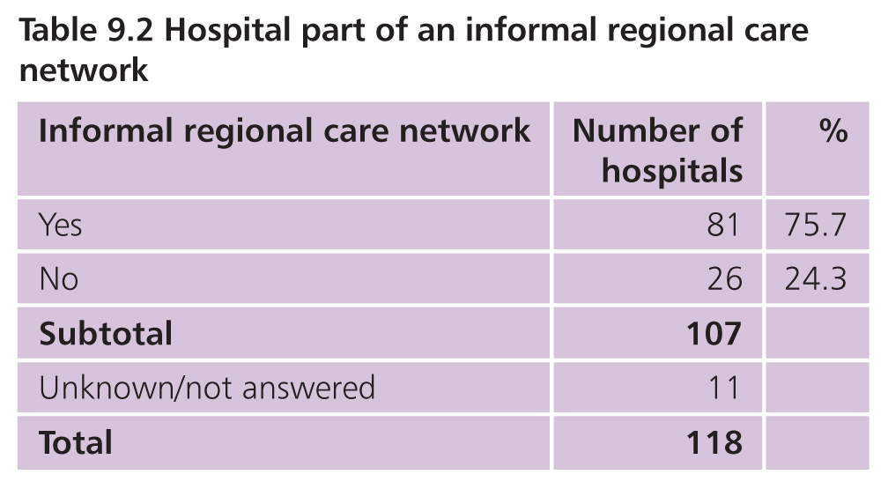
Informal network of care
Notes:
Of even greater concern, of those who weren’t, another quarter stated that were not even part of an informal network. But the truth is that informal networks are not an adequate response anyway to a severe acute emergency where life threatening complications can occur at any time.

Slide 57
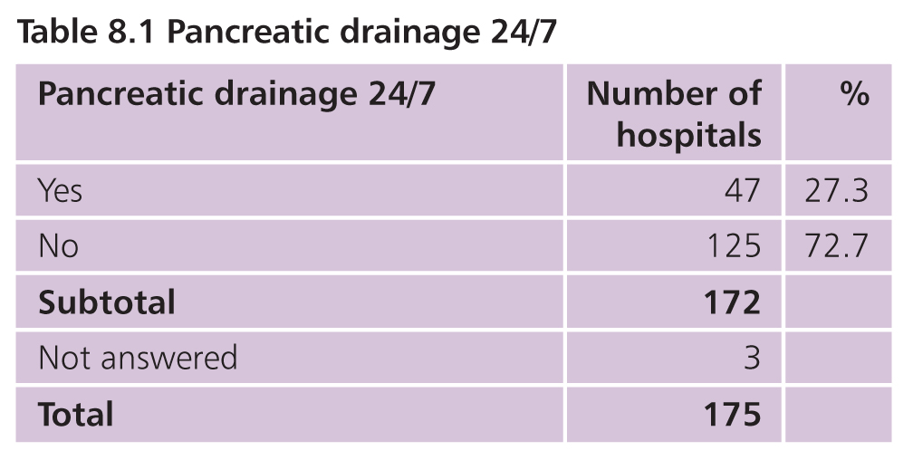
Pancreatic drainage
Notes:
So why do we need networks?
The first reason is that only 27% of cases said that they could place radiological drains on a 24/7 basis…

Slide 58
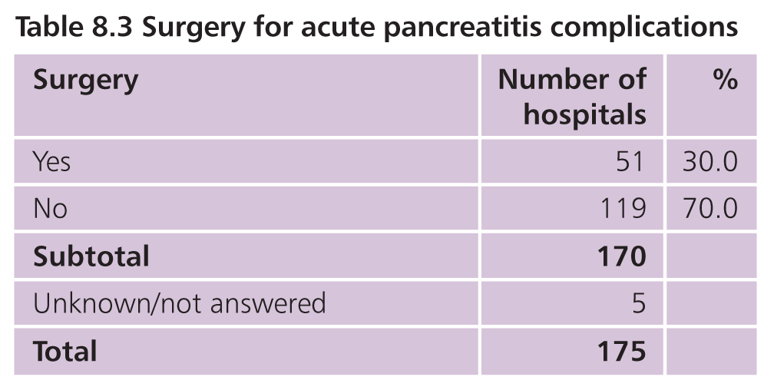
Availability of specialist surgery
Notes:
…And only 30% that they could perform pancreatitis surgery.

Slide 59
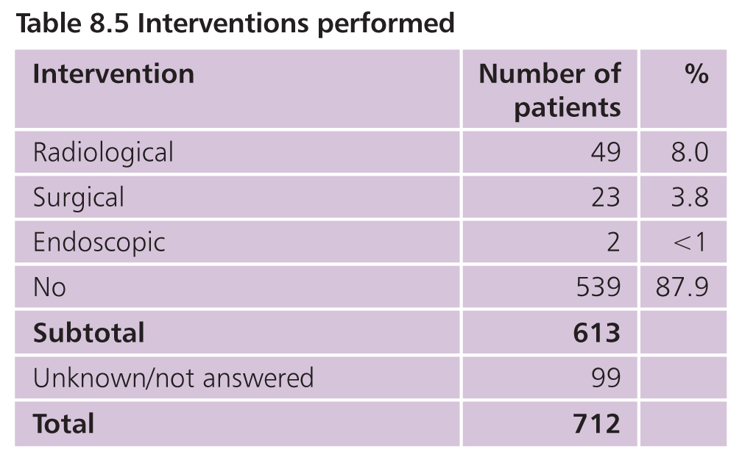
Interventions performed
Notes:
These are the procedures that were performed during the course of this study.
Mainly radiological drainage, some surgical necrosectomies and as yet, little endoscopic drainage/necrosectomy (although this is rapidly becoming more popular in the UK).
It is for these patients that we need reliable access to specialist centres 24/7, so that every patient has access to life saving treatments, regardless of which hospital they initially present.

Slide 60
Recommendation 16 - specialist centres
Specialist tertiary centres for acute pancreatitis should be commissioned.
...defined by the IAP as a high volume centre with intensive care facilities, daily access to radiological intervention, interventional endoscopy and surgical expertise in managing necrotising pancreatitis.
An example model to base this on could be the existing ‘Improving Outcomes Guidance’ compliant hepato-pancreato-biliary cancer units.
Notes:
We recommend the formal establishment & commissioning of specialist tertiary centres, as defined by the IAP.
And the existing IOG compliant HPB units in the UK, as these already meet service specifications and peer review requirements for 24/7 HPB surgical and interventional cover are well placed to provide this.

Slide 61
Outcomes & overall quality of care
Notes:
In conclusion, the outcomes for the patients in this study were as follows…

Slide 62
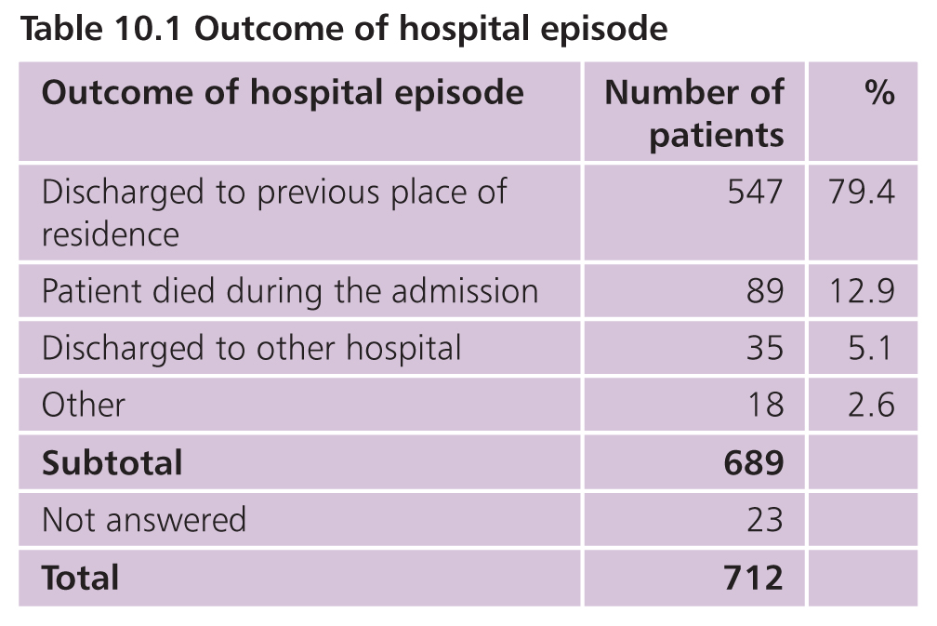
Outcomes
Notes:
79% discharged to their regular place of origin and 12.9% died. As outlined at the beginning, the inclusion criteria for this study deliberately sought to capture a cohort with a higher proportion of severe AP.

Slide 63
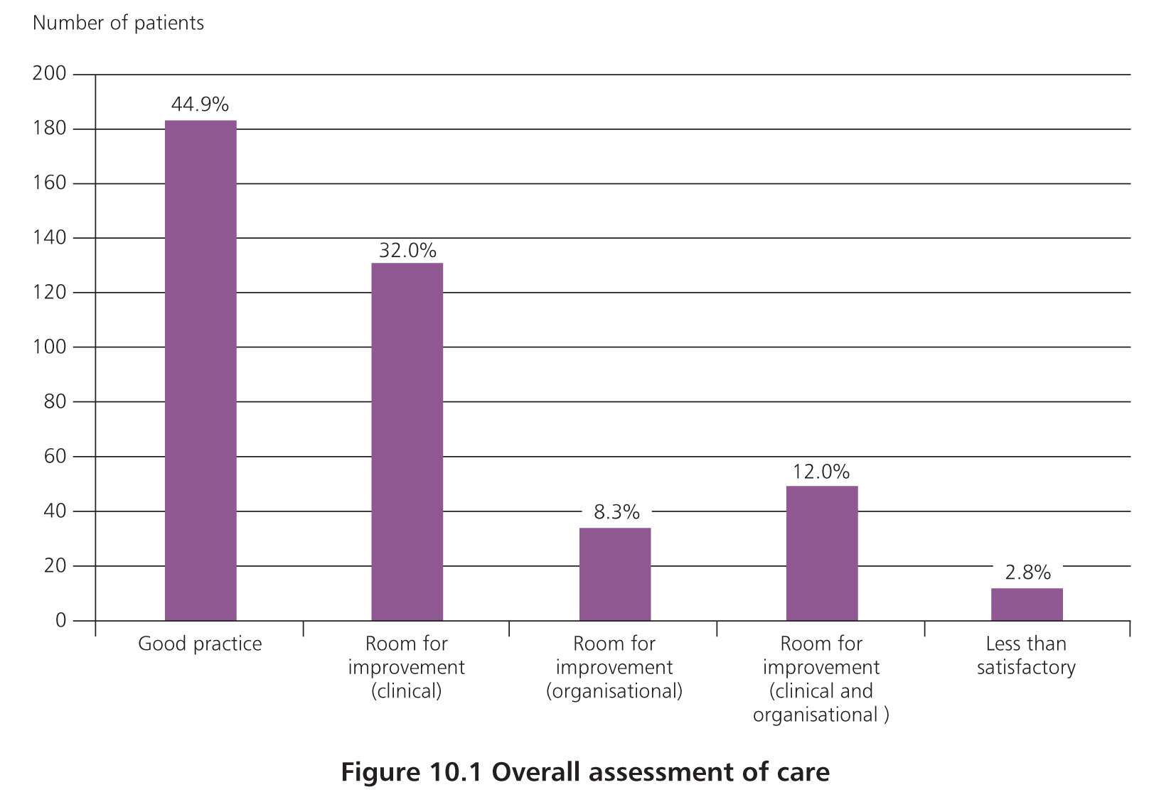
Overall quality of care
Notes:
The key feature and strength of an NCEPOD report is peer review; active NHS clinicians giving voluntarily of their time to review case notes as part of a national audit, with the sole purpose of seeking to improve outcomes.
Part of peer review is to grade overall quality of care and to identify where there is room for improvement; be that organisational, clinical or both.
In this study (quote figures)…
2.8%
Definition of less than satisfactory/never acceptable but at the lower end when compared with previous reports.

Slide 64
Conclusion
Much good news
But the full picture is more complex; there are many areas where we could be doing better
NCEPOD has identified these and produced recommendations for improvement

Slide 65
#AP
THANK YOU
www.ncepod.org.uk
To download the report

