Slide 1

A review of the quality of care provided to adult patients diagnosed with endometriosis
Key messages and recommendations

Slide 2
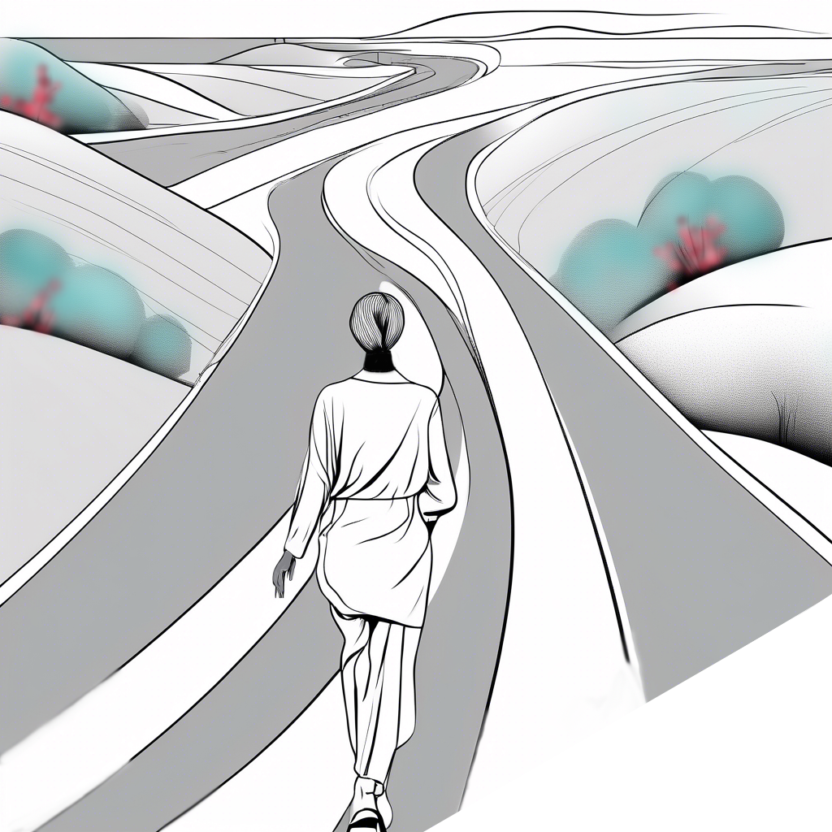
The Study
Study population:
Patients aged 18 or older with a primary surgical diagnosis of endometriosis admitted to hospital during the study timeframe: 1st February 2018 to 31st July 2020.
Data sources:
Clinician questionnaires
Case reviews
Organisational questionnaires
Primary care notes
Clinician survey
Patient survey

Slide 3
Study population
Inclusion criteria :
Patients aged 18 or older with a primary surgical diagnosis of endometriosis admitted to hospital during the study timeframe: 1st February 2018 to 31st July 2020.
Exclusions:
Patients with adenomyosis without endometriosis

Slide 4
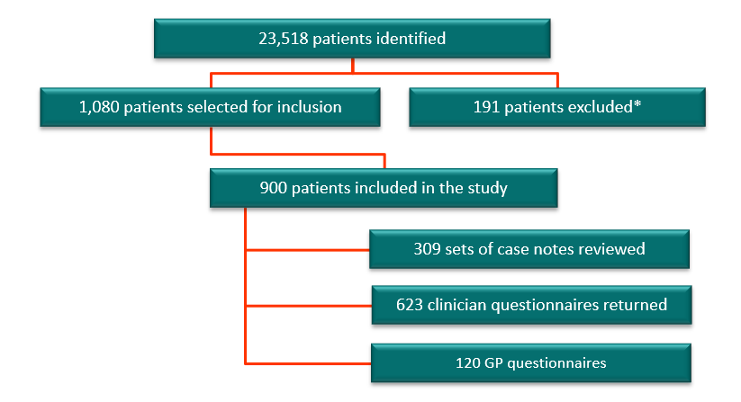
Data returns

Slide 5
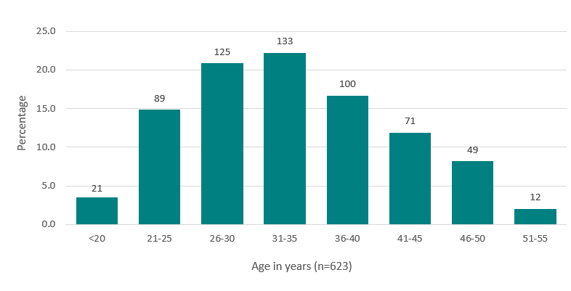
Age of patients included in the study population

Slide 6
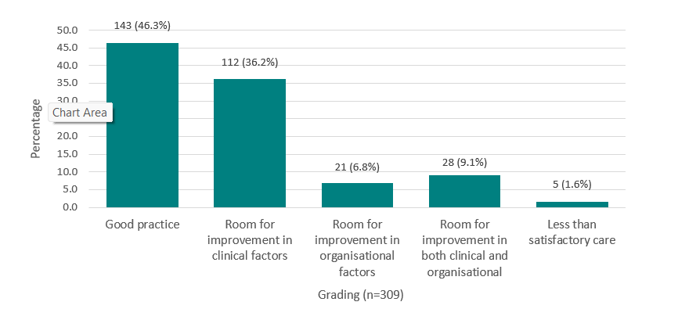
Overall quality of care

Slide 7
KEY MESSAGES

Slide 8
1
ENDOMETRIOSIS IS A CHRONIC CONDITION
Unlike other chronic conditions, such as diabetes, there is no pathway for endometriosis.
124/238 (52.1%) patients experienced recurrence or persistence of endometriosis symptoms following laparoscopy

Slide 9
2
ENDOMETRIOSIS HAS SYMPTOMS AND SIGNS THAT NEED EARLIER RECOGNITION & APPROPRIATE TIMELY MANAGEMENT
Signs and symptoms of endometriosis need to be recognised and not just seen as troublesome periods.
546/941 (58.0%) patients surveyed had multiple visits to the GP before any investigations were undertaken or treatment initiated.

Slide 10
3
ENDOMETRIOSIS AFFECTS QUALITY OF LIFE. ALL PATIENTS SHOULD BE ASKED ABOUT ITS EFFECT ON THEIR LIFE
Access to supportive services would enable patients with endometriosis to manage their condition.
420/941 (44.6%) of survey respondents stated that they were not asked at any point about the impact of symptoms on their quality of life.

Slide 11
4
ENDOMETRIOSIS REQUIRES HOLISTIC, JOINED-UP, MULTIDISCIPLINARY CARE
Multidisciplinary care is essential to ensure patients with endometriosis have all their care needs met.
Reviewers found that only 27/242 (11.2%) patients were formally discussed in an MDT meeting and 28/215 (13.0%) patients who were not discussed should have been.

Slide 12
RECOMMENDATIONS

Slide 13
Public awareness and education
Raise awareness about endometriosis symptoms with the public and patients, highlighting that it is a chronic condition and how they can seek help. Primary audiences: NHS England, Welsh Government, Northern Ireland Department of Health Supported by: Royal College of Obstetricians and Gynaecologists, Royal College of General Practitioners, Royal College of Surgeons, Royal College of Emergency Medicine, Royal College of Nursing, Royal College of Paediatrics and Child Health, Department for Education, Endometriosis UK, Endometriosis Cymru

Slide 14
Awareness of endometriosis as a chronic condition
Raise awareness with all healthcare professionals that endometriosis is a chronic condition and should be treated as such. Primary audiences: Royal College of Obstetricians and Gynaecologists, Royal College of General Practitioners, Royal College of Surgeons, Royal College of Emergency Medicine, Royal College of Nursing, Royal College of Paediatrics and Child Health, Society for Acute Medicine, British Society for Gynaecological Endoscopy
Supported by: NHS England, Welsh Government, Northern Ireland Department of Health

Slide 15
Training for healthcare professionals
Improve training on the recognition of symptoms of endometriosis, such as pelvic pain and heavy menstrual bleeding.
In primary care - to support healthcare professionals in the initial assessment, and any ongoing care of patients
In secondary care - enhanced training on endometriosis should be made available for all healthcare professionals who might care for patients with endometriosis.
Primary audiences: Royal College of Obstetricians and Gynaecologists, Royal College of General Practitioners, Royal College of Emergency Medicine, Royal College of Nursing, Royal College of Paediatrics and Child Health, British Society for Gynaecological Endoscopy
Supported by: NHS England, Welsh Government, Northern Ireland Department of Health

Slide 16
Impact of endometriosis on quality of life
Ask patients with endometriosis about the effects it has over and above physical symptoms, including its impact on their daily life and refer them as needed to support services (e.g. psychology/pain services), at all stages of the pathway. Primary audiences: Healthcare professionals in primary care and secondary care

Slide 17
Impact of endometriosis on quality of life
Ensure multidisciplinary teams/clinical networks are set up and utilised across all healthcare settings to help agree treatment plans and support women with confirmed endometriosis. Input from specialties should be proportionate to the patient’s needs. Primary audiences: Integrated care boards, Commissioners, Clinical Directors and Executive Boards
Supported by: Royal College of Obstetricians and Gynaecologists, Royal College of General Practitioners, Royal College of Emergency Medicine, Royal College of Nursing, Royal College of Paediatrics and Child Health, British Society for Gynaecological Endoscopy, Commissioners

Slide 18
Multidisciplinary teams and clinical networks
Ensure multidisciplinary teams/clinical networks are set up and utilised across all healthcare settings to help agree treatment plans and support women with confirmed endometriosis. Input from specialties should be proportionate to the patient’s needs. Primary audiences: Integrated care boards, Commissioners, Clinical Directors and Executive Boards
Supported by: Royal College of Obstetricians and Gynaecologists, Royal College of General Practitioners, Royal College of Emergency Medicine, Royal College of Nursing, Royal College of Paediatrics and Child Health, British Society for Gynaecological Endoscopy, Commissioners

Slide 19
Medical/ pain management for endometriosis
Manage pain effectively for patients who have endometriosis: Set a low threshold for the prescription of analgesia Set a low threshold for hormonal treatment which may improve pain as well as other symptoms – while always considering fertility intentions Refer to pain management services as needed In parallel, refer patients for non-medical pain management e.g. physiotherapy Primary audiences: All healthcare professionals in primary, secondary, and specialist care who are in contact with people who have endometriosis Supported by: Royal College of General Practitioners

Slide 20
Consent for laparoscopies for endometriosis
Provide patients with clear, written information as part of the process that allows the patient to give informed consent for the laparoscopic diagnosis/treatment of endometriosis. This should form the basis of a documented discussion with the surgeon before the day of surgery. Include: What the procedure involves The purpose of the procedure e.g. to diagnose, stage, treat the symptoms of endometriosis, or a combination of these What the patient’s expectations are The possible effects on endometriosis symptoms Risks, benefits and limitations The need for further laparoscopic/open surgery for recurrent endometriosis or if complications arise This is consistent with NICE guideline NG73 Primary audiences: Consultant surgeons

Slide 21
Discharge, follow-up and readmission
Provide patients with clear, written information at discharge following laparoscopic diagnosis/treatment of endometriosis, including who to contact and how to initiate direct access back into the endometriosis care pathway.
Who to contact if they have any concerns, e.g. GP, endometriosis clinical nurse specialists, consultant
The follow-up plan and ongoing management of the endometriosis
The option of patient-initiated follow-up
Types and dosages of medication they are on at discharge, including analgesia and hormone therapy
The consideration of bone health for people with endometriosis on long-term hormonal medication, including nutrition, weight-bearing exercise and alcohol intake
Primary audiences: All healthcare professionals who care for patients with endometriosis
Supported by: Clinical Directors

Slide 22
The endometriosis care pathway
Formalise a care pathway for patients with or suspected to have endometriosis. This pathway should include implementation of NICE guideline NG73, the European Society of Human Reproduction and Embryology (ESHRE) endometriosis guidelines, as well as the recommendations from this report. Primary audiences: Royal College of Obstetricians and Gynaecologists, Royal College of General Practitioners, Royal College of Surgeons, Royal College of Emergency Medicine, Royal College of Nursing, Royal College of Paediatrics and Child Health, Society for Acute Medicine, British Society for Gynaecological Endoscopy, British medical ultrasound society, Pelvic Obstetric and Gynaecological Physiotherapy Supported by: NHS England, Welsh Government, Northern Ireland Department of Health

Slide 23
Further opportunities to improve endometriosis care
Collect surgical outcome data, including patient-reported outcomes, for benchmarking. Review local practice against NICE guideline NG73, the recommendations in this report. Undertake clinical trials to ascertain the efficacy of surgery for endometriosis-associated symptoms, especially for minimal or mild endometriosis. Assess the use of pain medication, and the medical treatment of endometriosis. Explore the use of imaging modalities in the diagnosis of endometriosis. Primary audiences: Grant-making bodies such as the National Institute for Health and Care Research or Medical Research Council
Supported by: Relevant Royal Colleges

Slide 24
REPORT and TOOLS
www.ncepod.org.uk/2024endometriosis
Report
Summary
Infographic
Recommendation checklist
Audit tool
Driver diagram
Fishbone diagram
Commissioners guide

